Slide 1
Reporting from R
BIOF 339
November 28, 2017

Slide 2
The data science pipeline
Notes:
The data pipeline ends in some sort of report

Slide 3
The data science pipeline

Slide 4
Markdown
Markdown is a light text markup language that was originally meant to make writing HTML web pages easier
Easy to learn
Quick to process

Slide 5
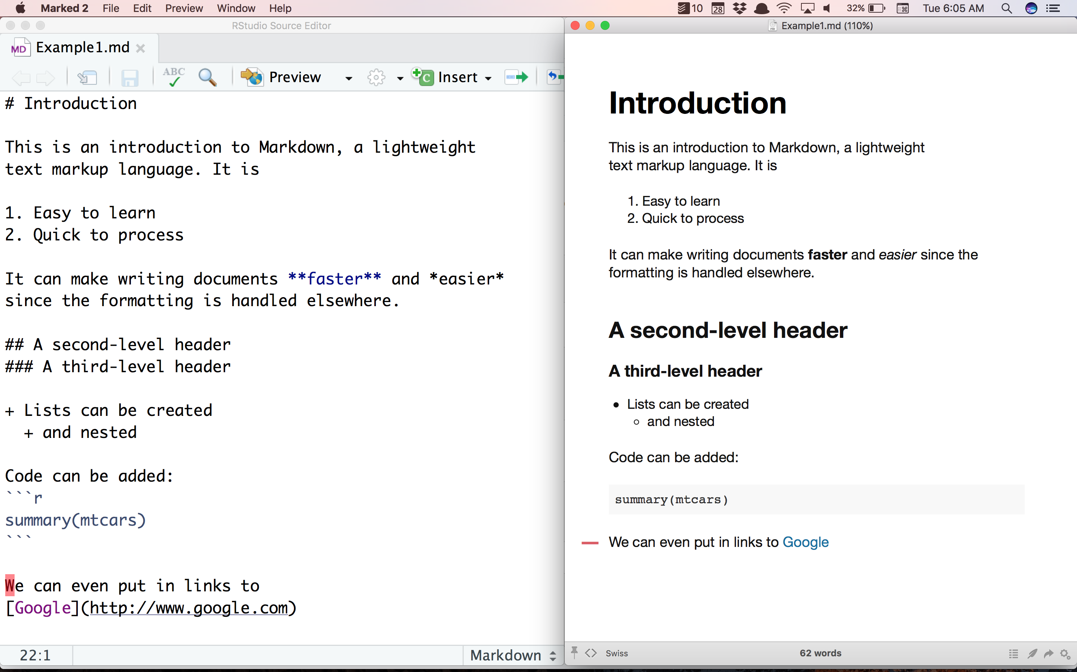
Notes:
A basic markdown document

Slide 6
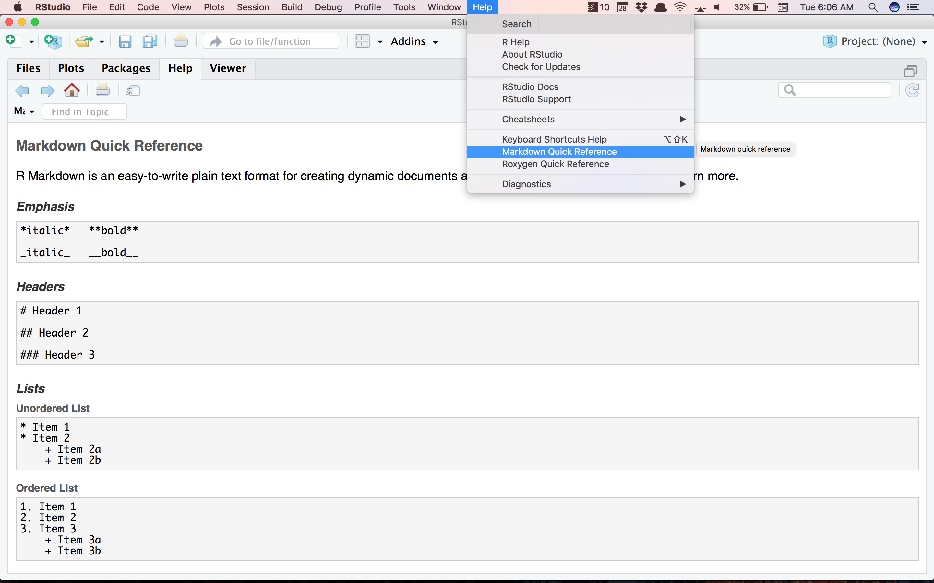
Notes:
RStudio provides a markdown reference

Slide 7
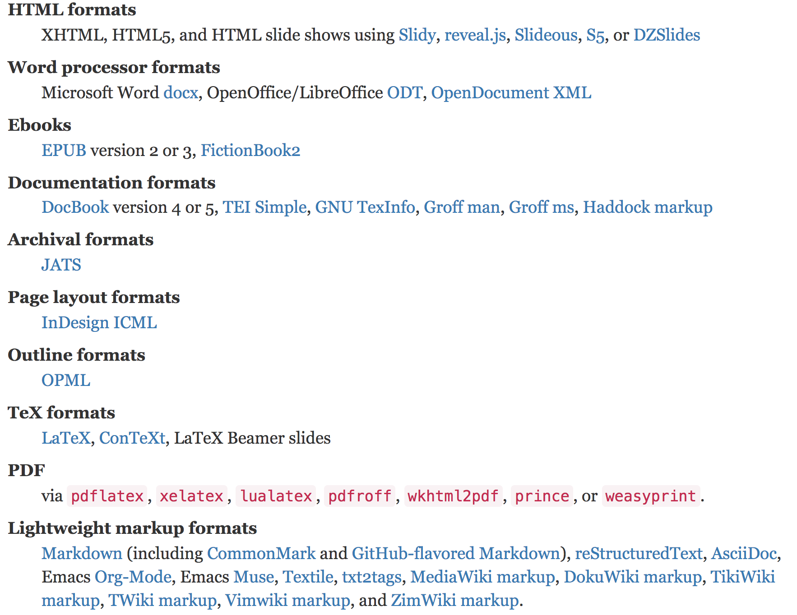
Pandoc
Pandoc is the secret sauce for markdown
It can take a Markdown file and convert it to:
Notes:
Pandoc can take other forms of documents as inputs too, but here we’re just going to talk about markdown inputs. (The header is a link)

Slide 8
Pandoc
Pandoc allows you to
Write one source document in text
Iterate a formatted version using HTML (quick)
Create a final version in
Word
PDF
Send off to your collaborators

Slide 9
Pandoc
You can certainly add formats to your documents as templates
Add citations to documents (we’ll see that later)
See the pandoc documentation for all the gory details
pandoc.org

Slide 10
R Markdown

Slide 11
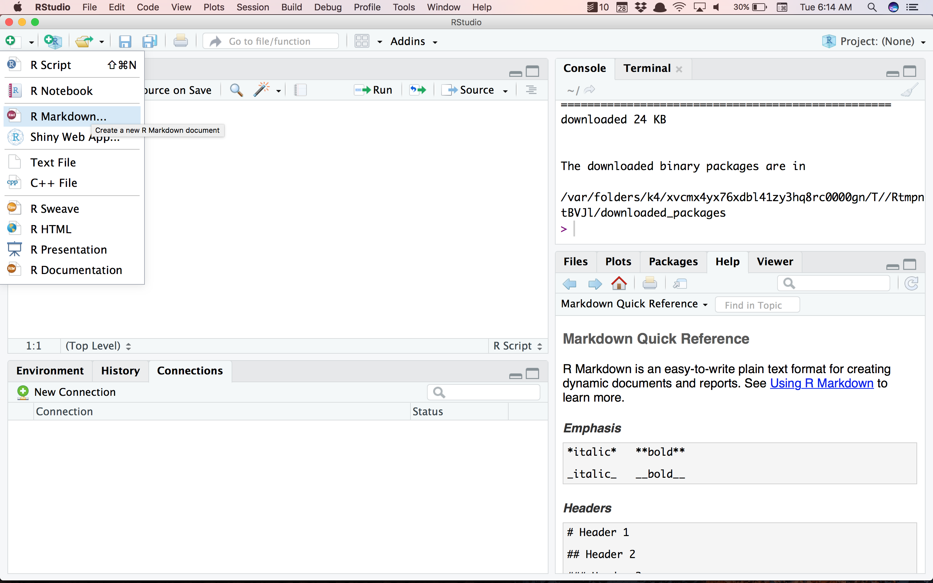

Slide 12
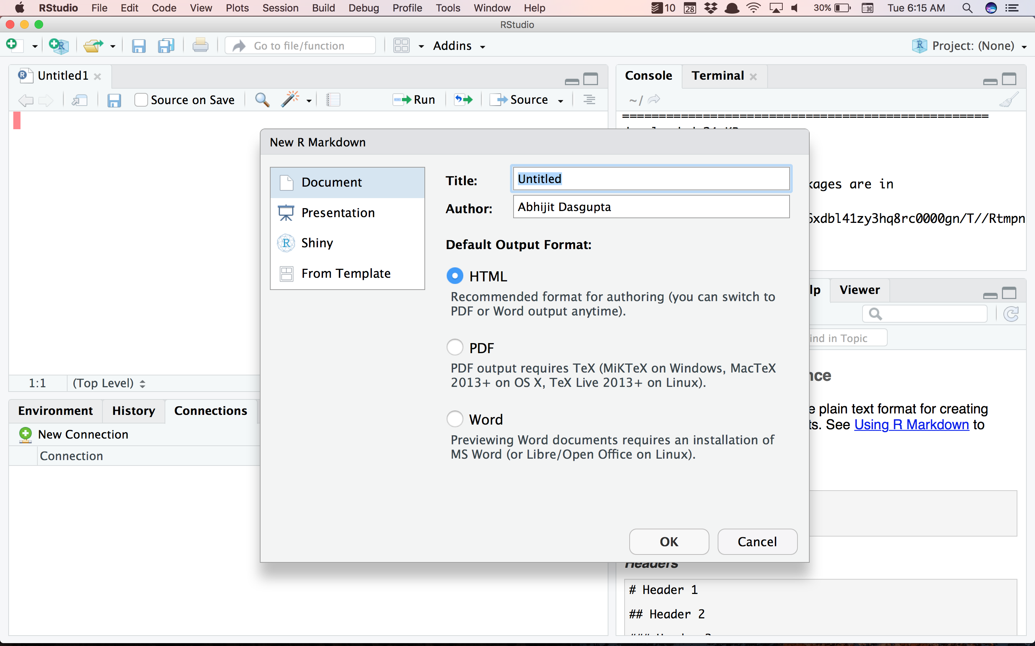

Slide 13
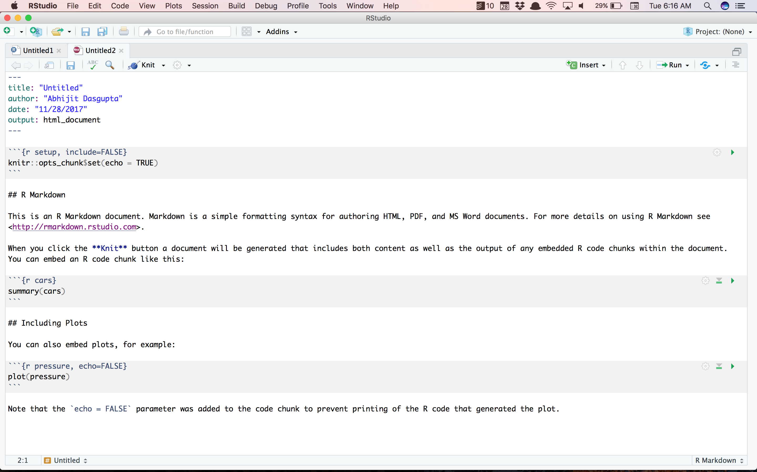

Slide 14
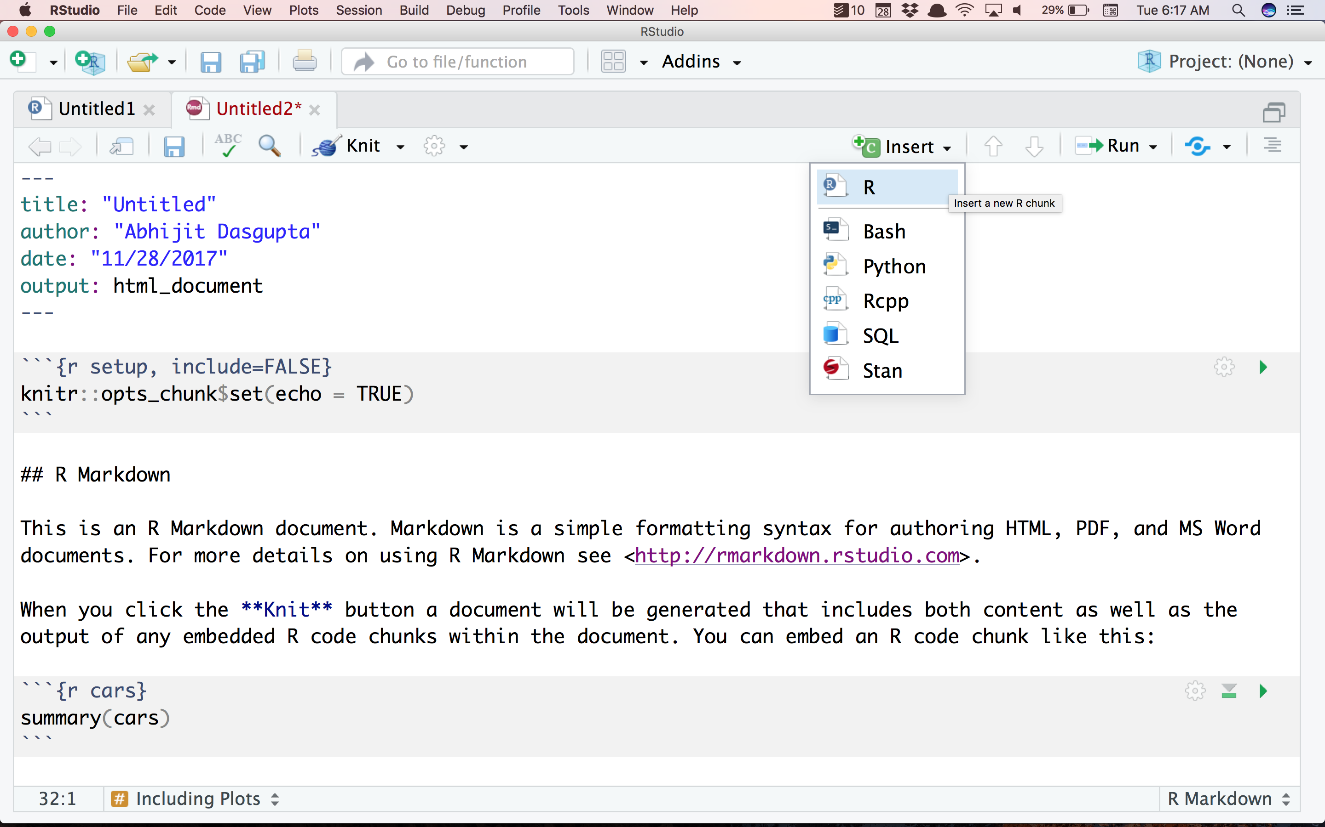

Slide 15
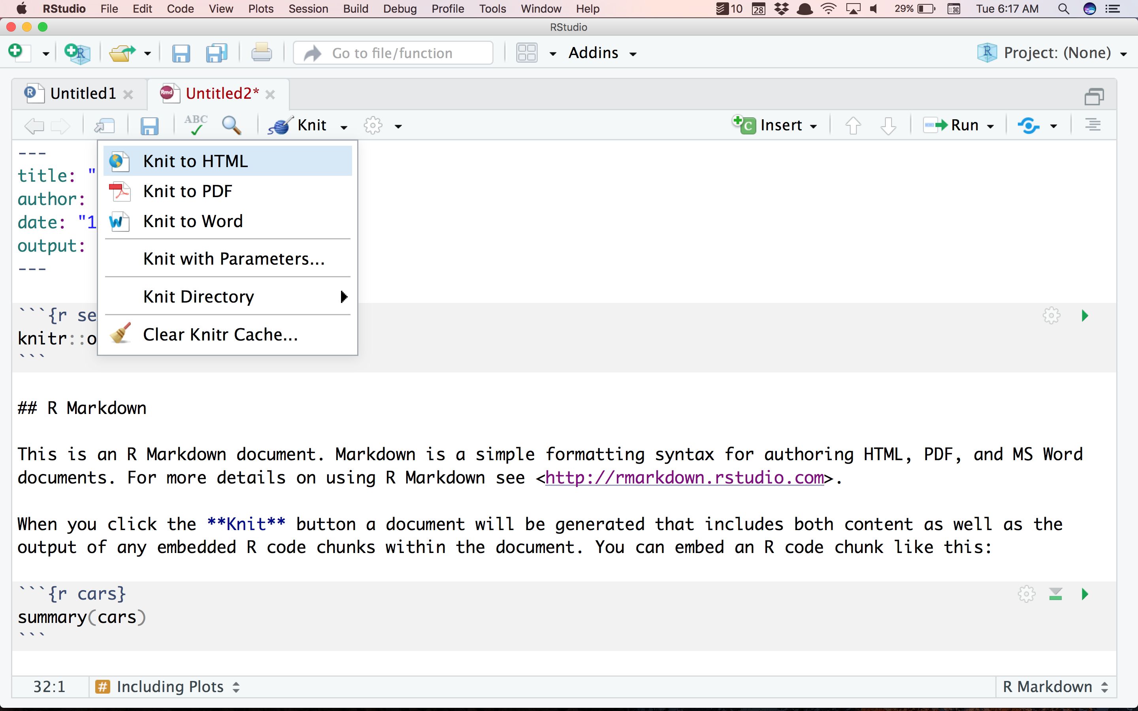
HTML
Word
PDF

Slide 16
HTML
Pandoc
R Markdown
Markdown
Word
knitr
Pandoc
PDF
Pandoc + LaTeX

Slide 17
Weaving documents
Weaving text and code to produce documents
The R package rmarkdown
Installs and uses pandoc for you
Is baked into RStudio
Uses knitr implicitly

Slide 18
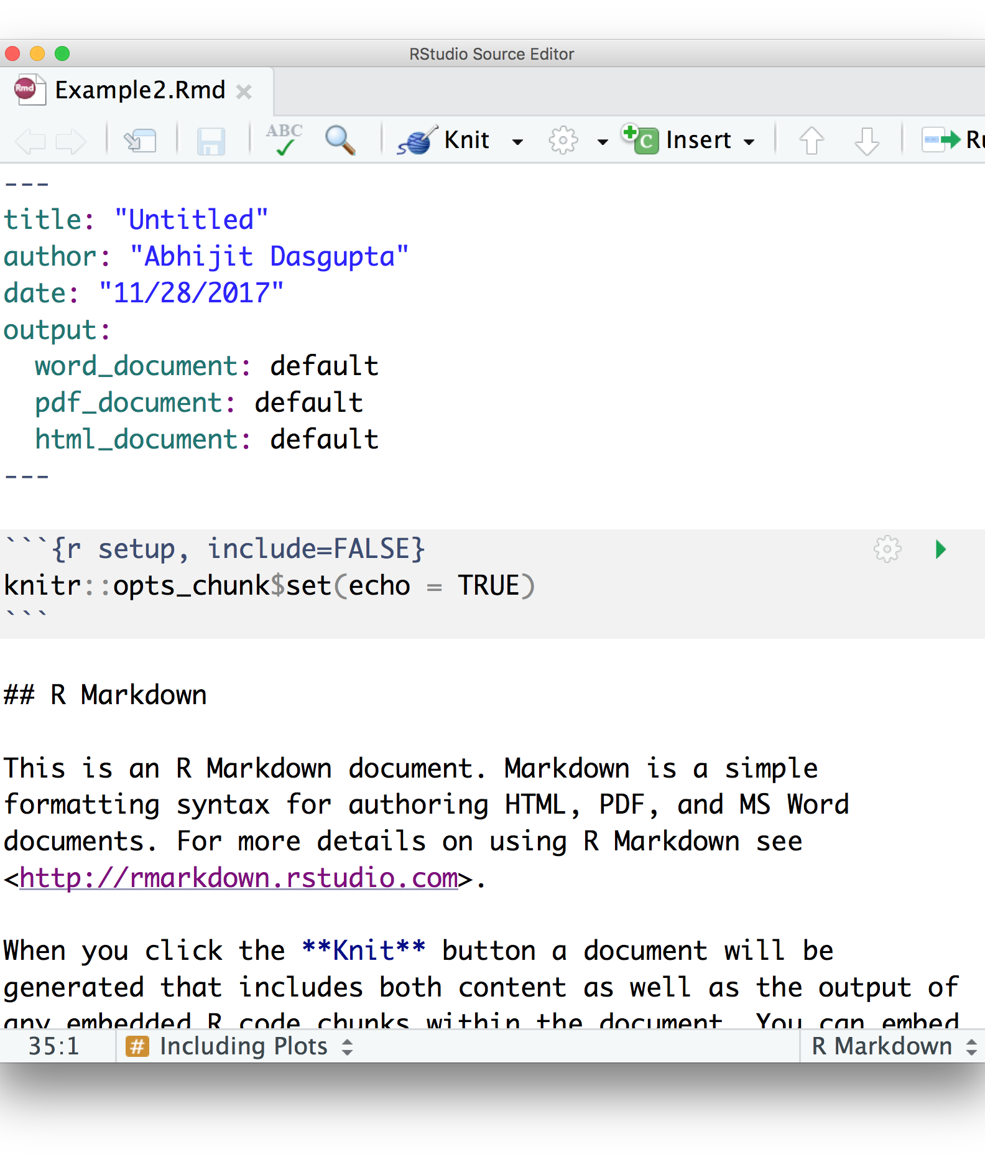
Structure
Header
Starts and stops with 3 dashes
Tells rmarkdown how to process the file

Slide 19
Structure
Code chunk
Starts with ```{r}
Can name the chunk using ```{r name}
Can add options separated by commas
Any valid R code can be put in chunk
Ends with ```

Slide 20
Structure
Inline code and results
Inline code starts with `r and ends with `
Results should be numerical or text, nothing complex

Slide 21
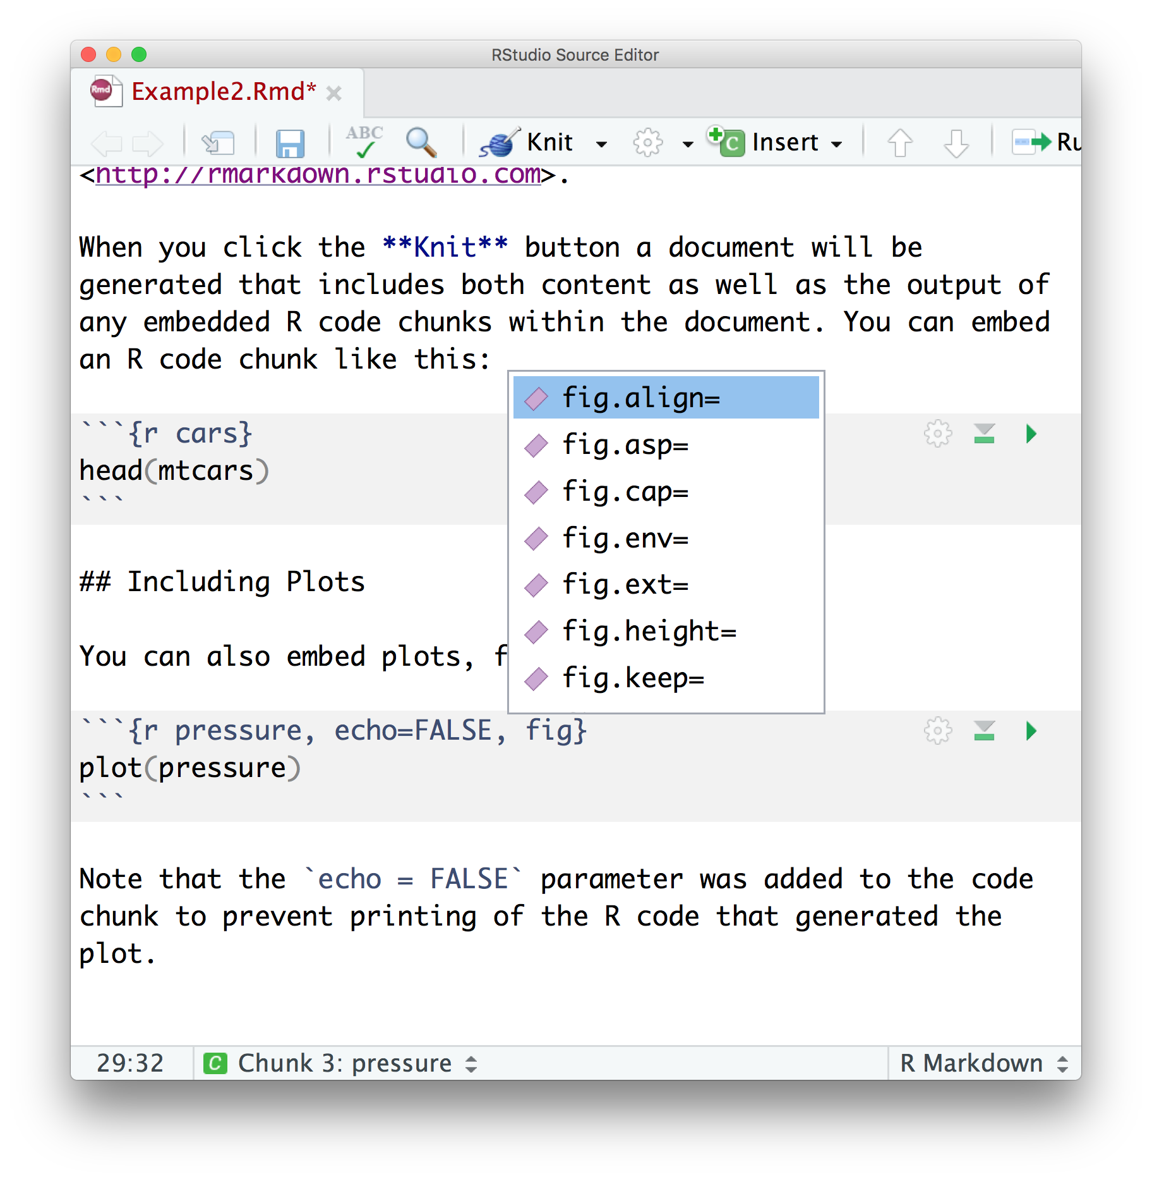
rmarkdown is baked into RStudio
Chunk options show up as tooltips
See the knitr documentation for all options
https://yihui.name/knitr

Slide 22
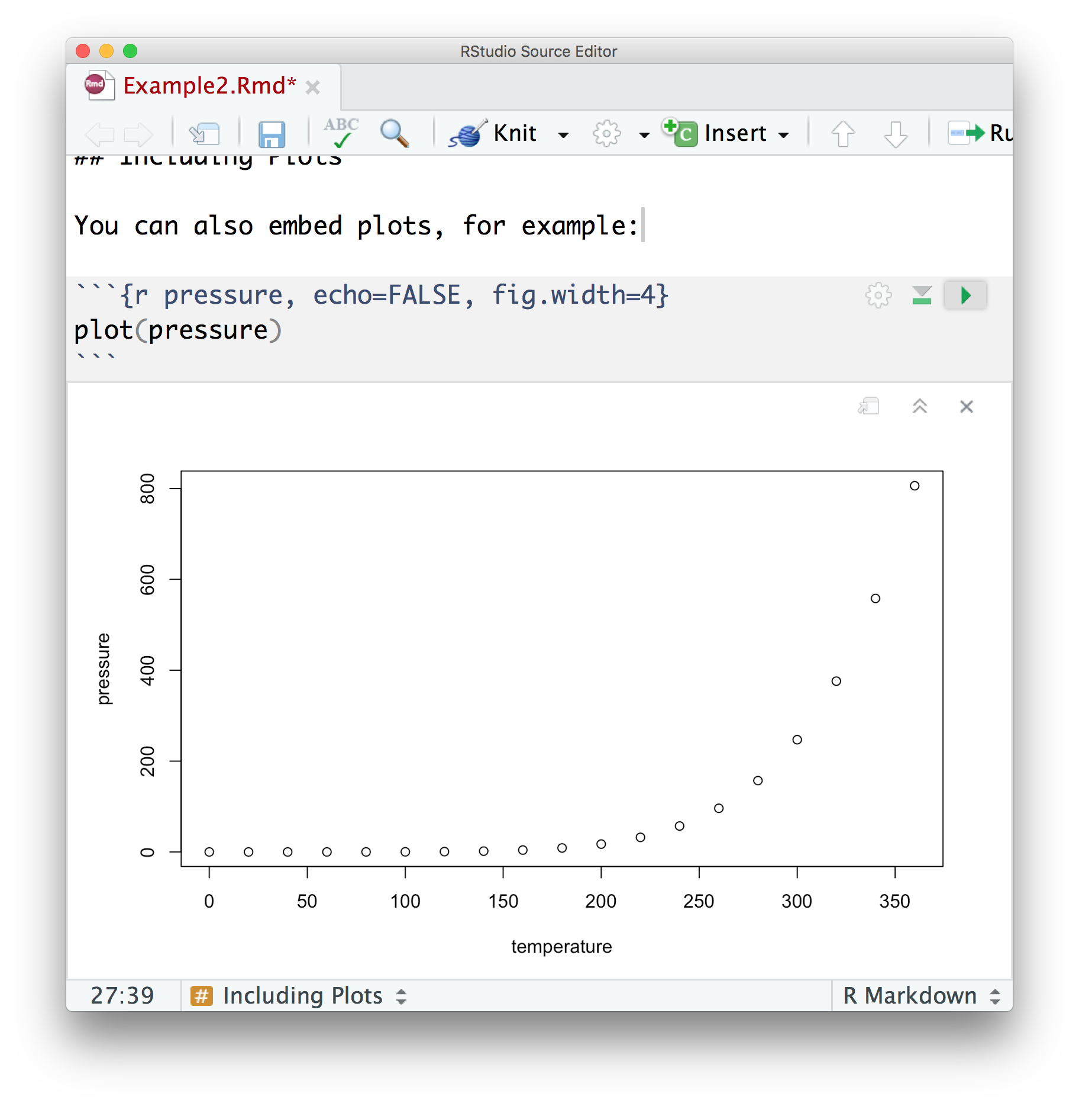
rmarkdown is baked into RStudio
Chunk options show up as tooltips
Running a chunk will show results in code window

Slide 23
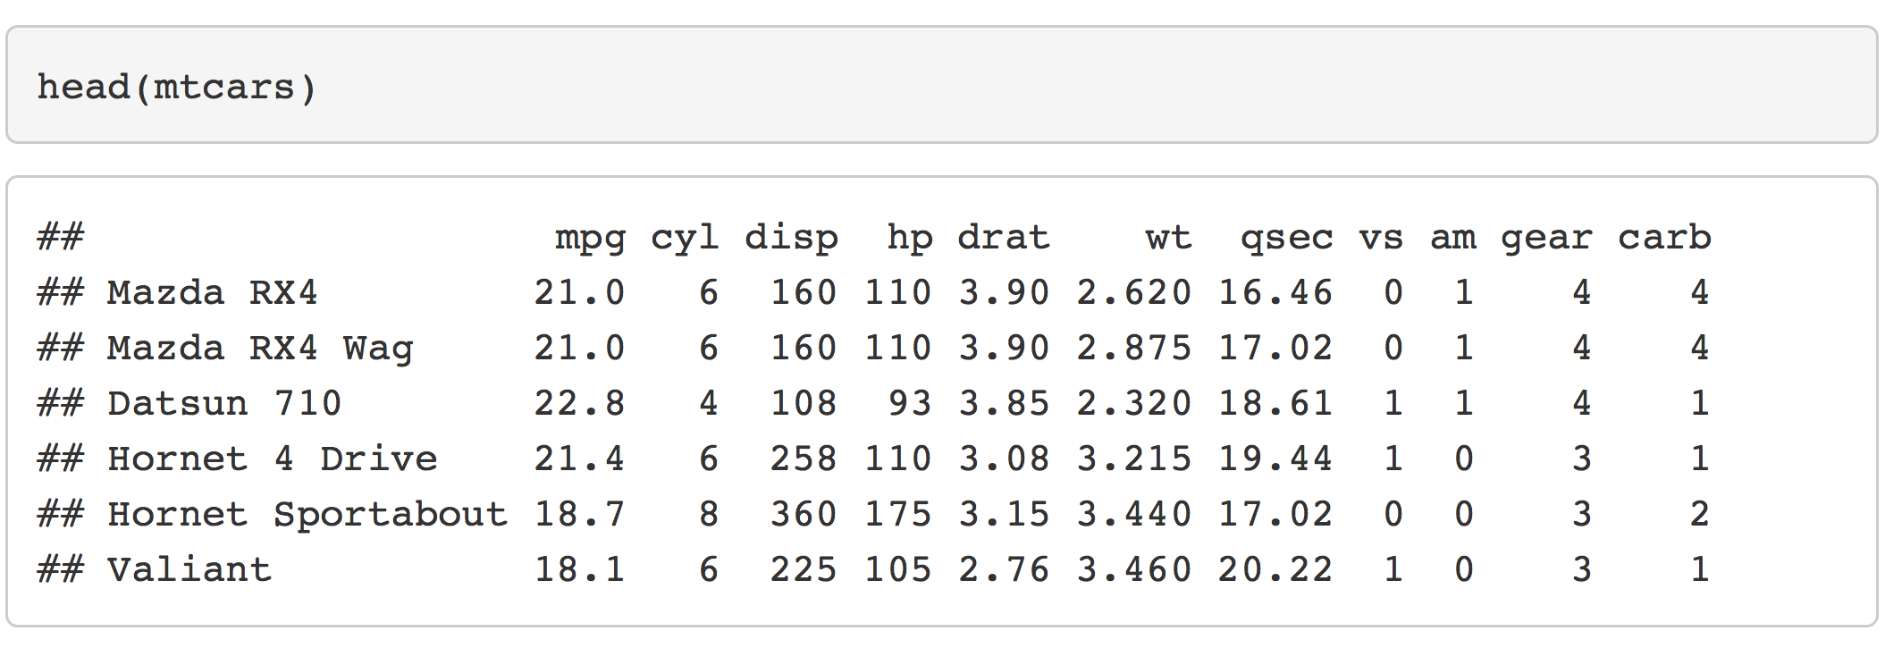
Formatting output
Default behavior
Puts ## in the beginning of lines

Slide 24
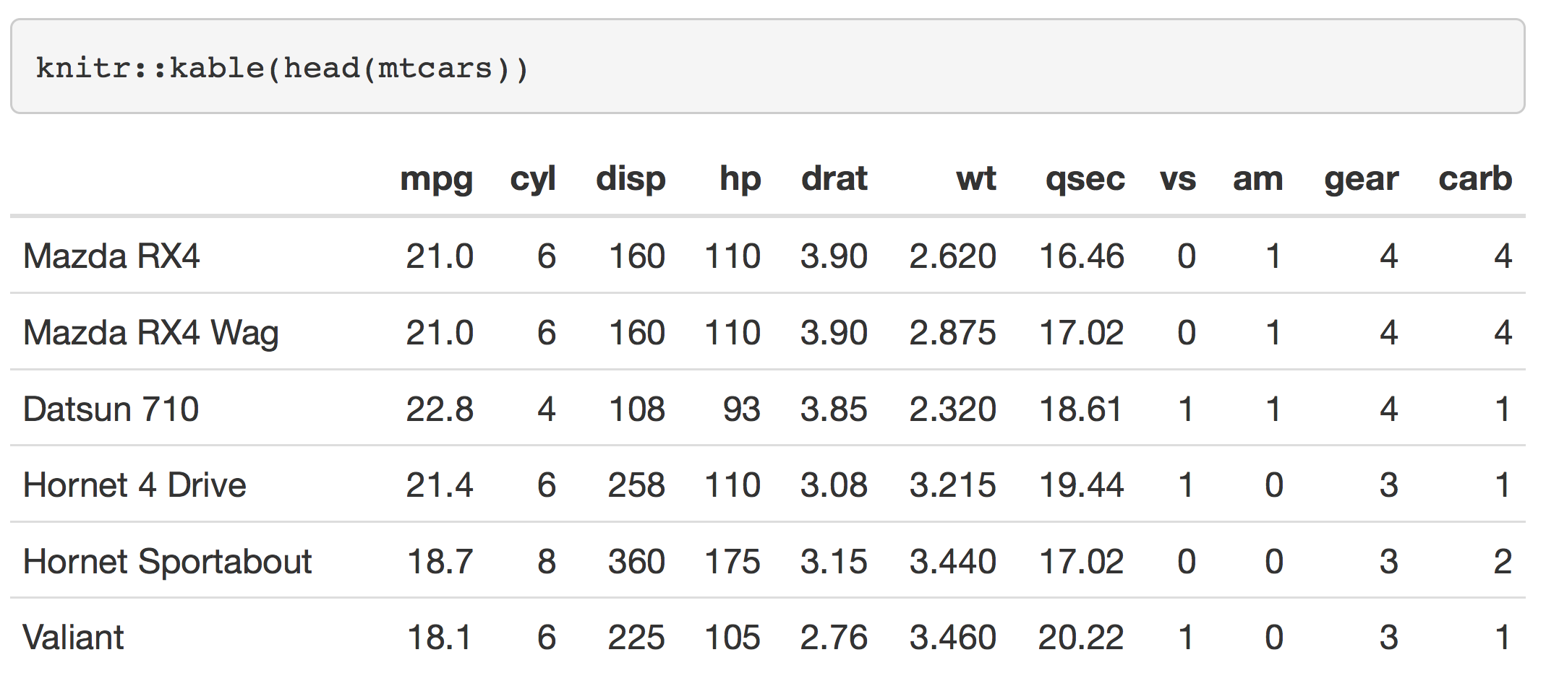
Formatting output
Use knitr::kable
Formats tables

Slide 25
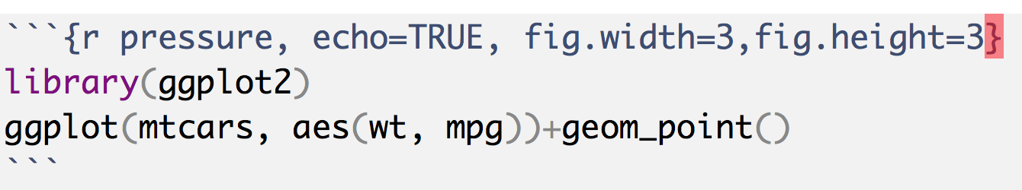
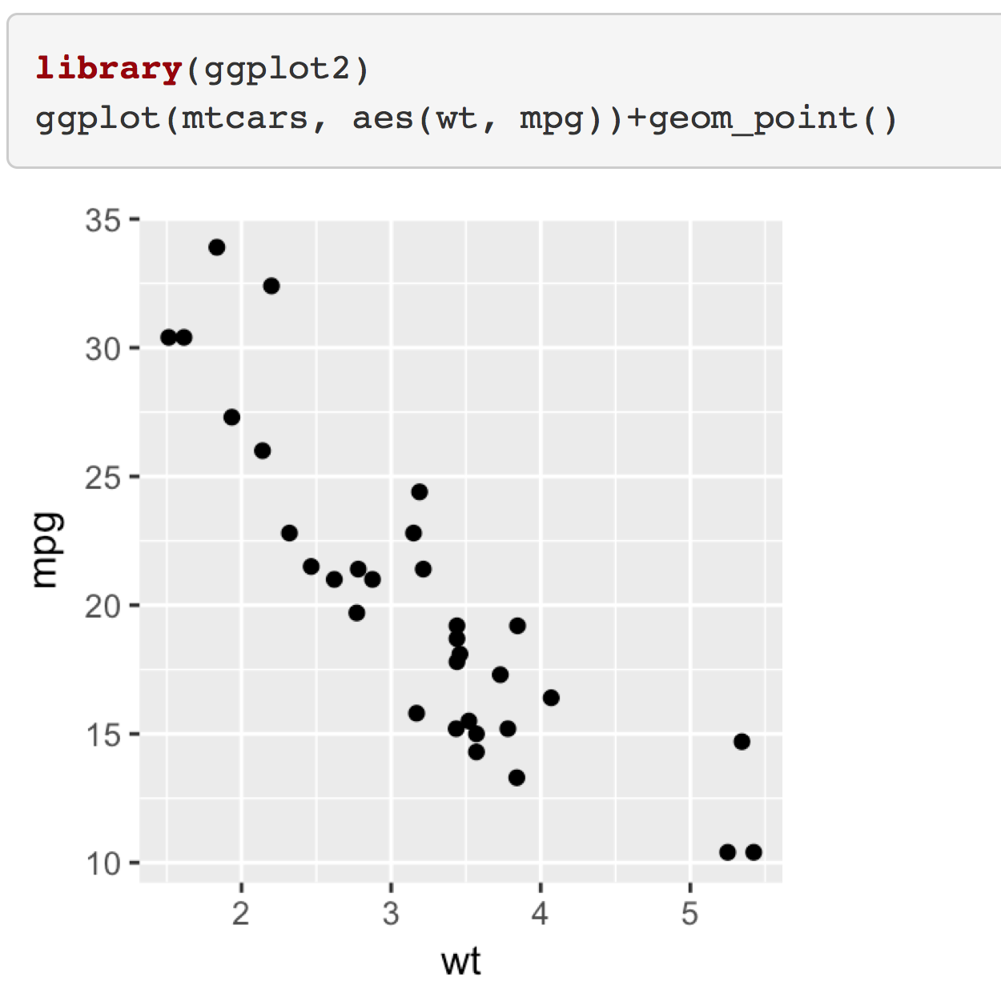
Formatting output
ggplot works well with rmarkdown
Note that changing to echo=FALSE will suppress the code in the output

Slide 26
Formatting output
broom::tidy is your friend

Slide 27
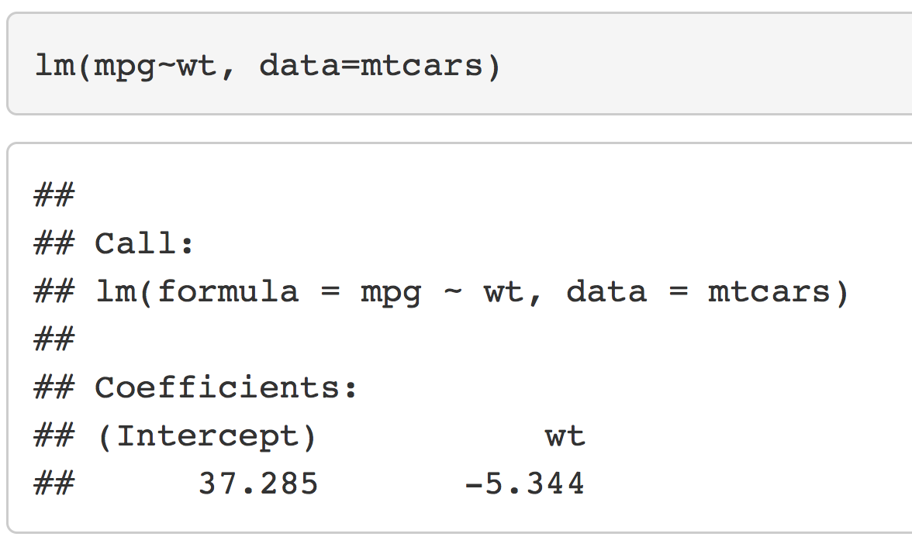
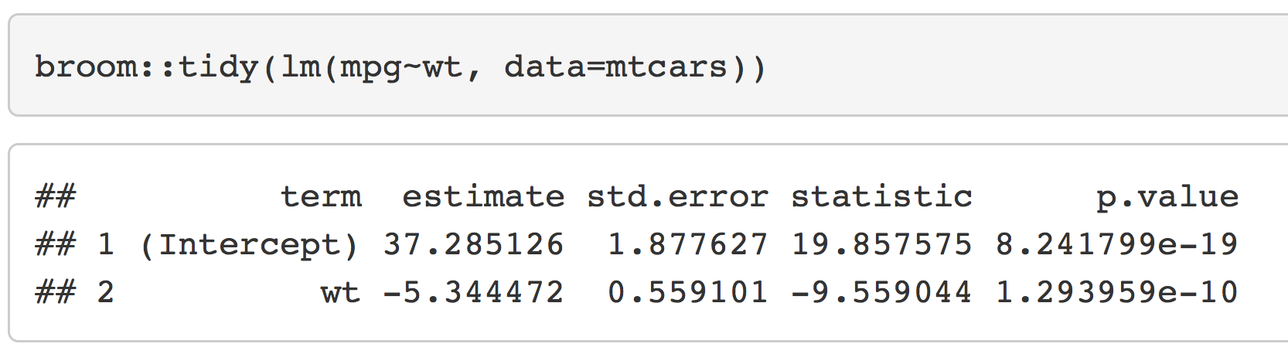
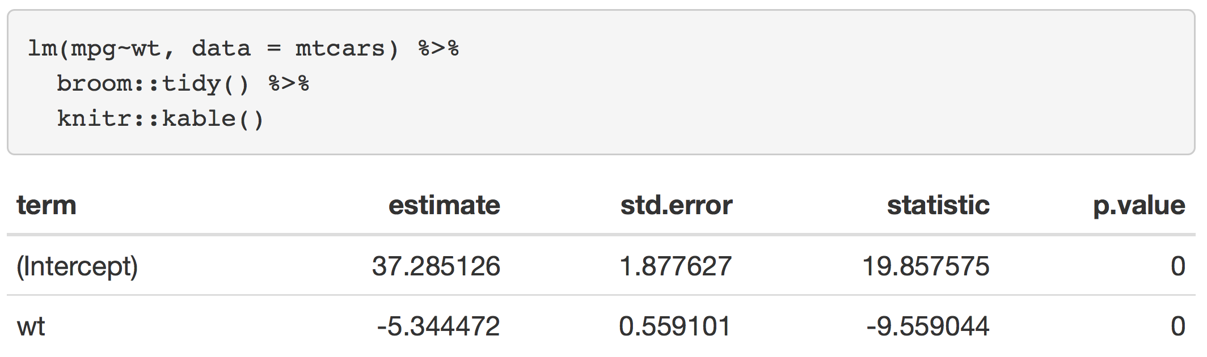
Formatting output

Slide 28
Formatting output
Installing LaTeX offers much finer control of the document
You don’t have to learn LaTeX!!
It will work as a backend for pandoc and rmarkdown
Can use quite a bit more involved templates
Search for
Windows: MikTeX
Mac: MacTeX
Linux: texlive

Slide 29
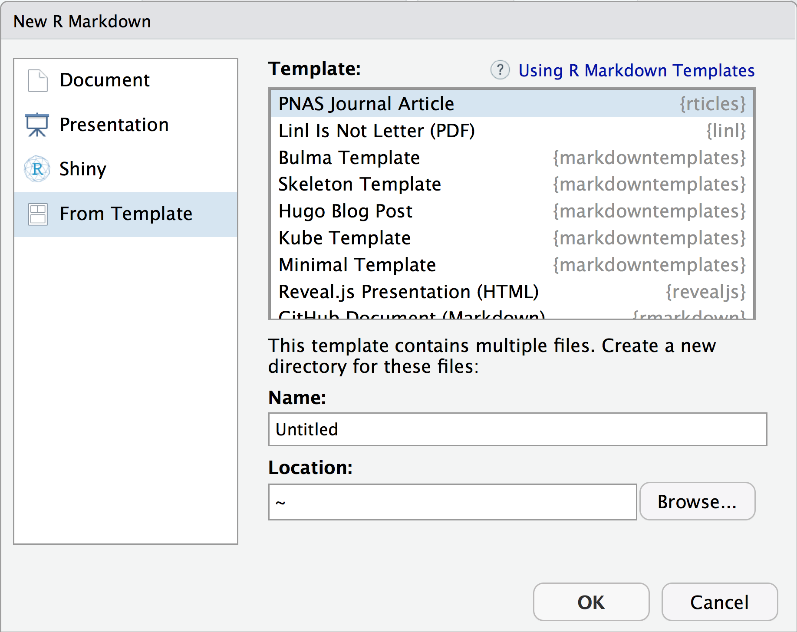
Formatting output
The rticles R package provides this

Slide 30
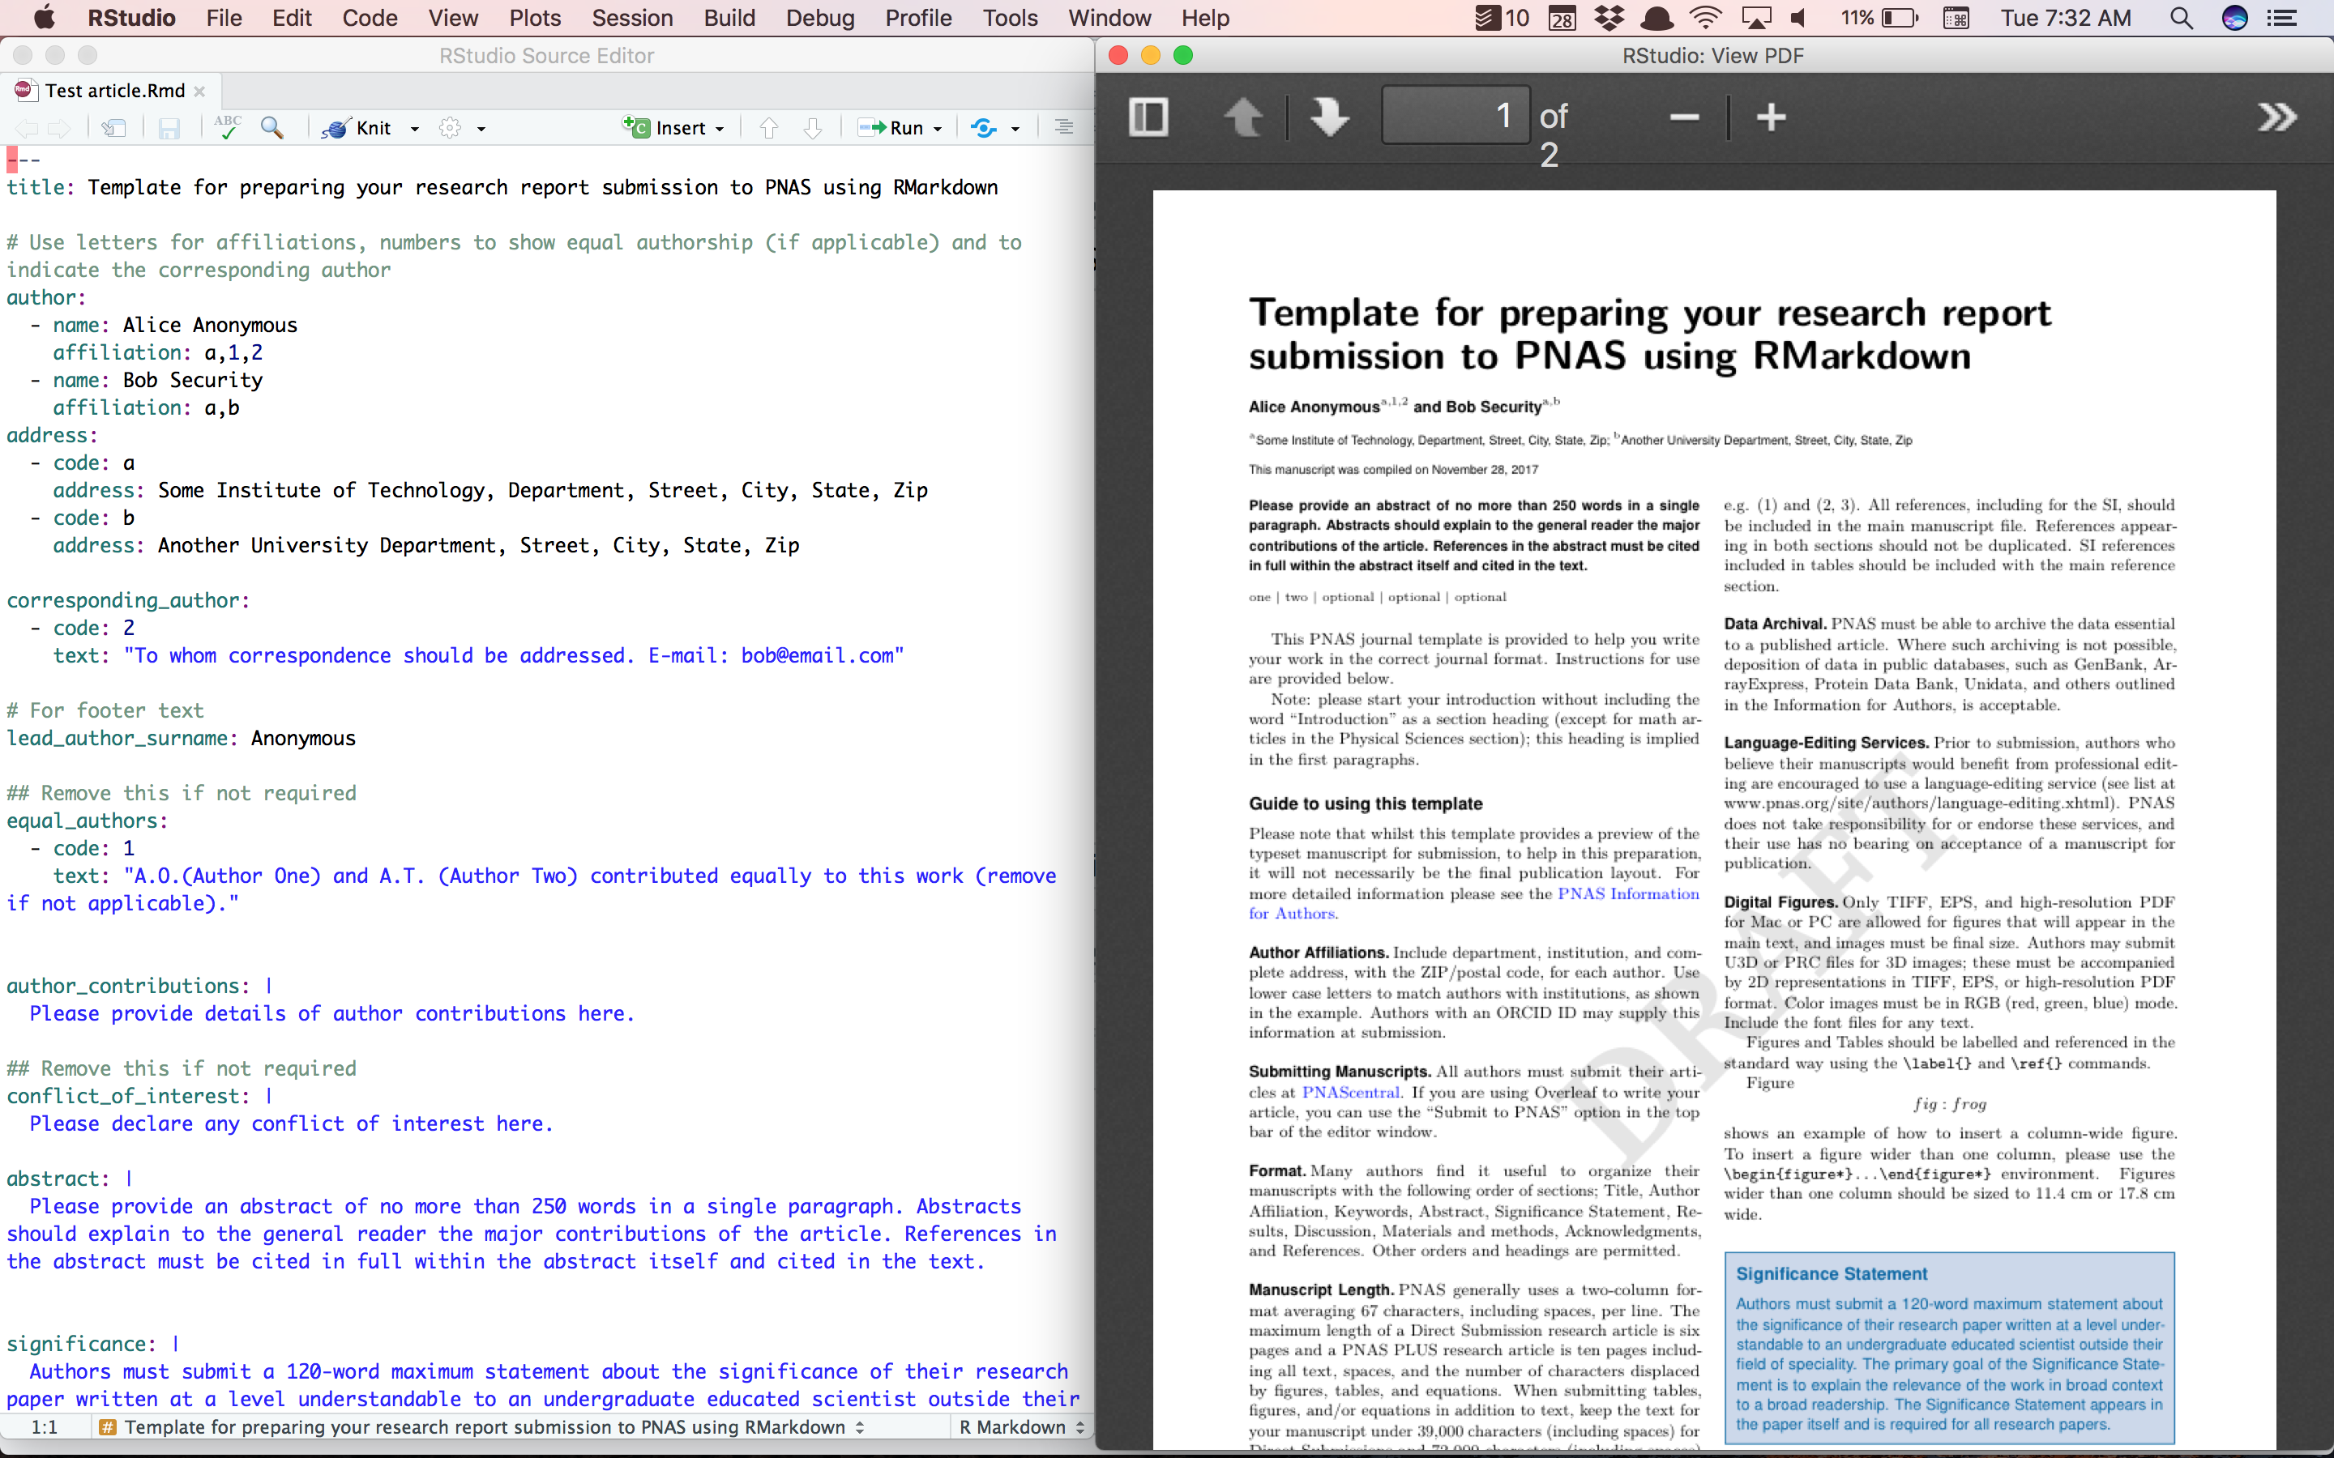

Slide 31
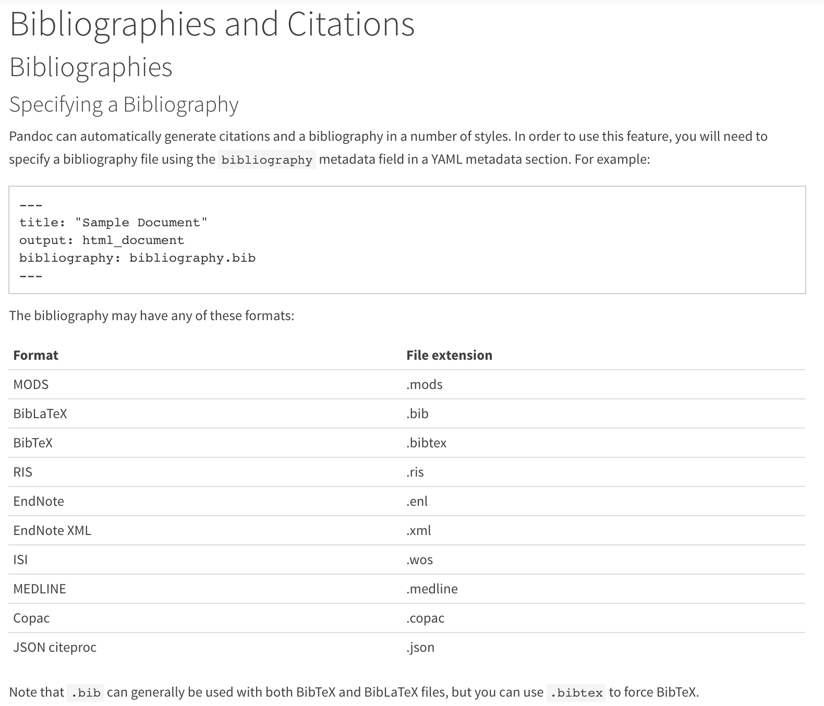
Citations and bibliographies
Link

Slide 32
Resources
A genomics example (link)
An R Markdown Template for Academic Documents (link)
Reproducible Reporting with R Markdown (link)

Slide 33
Slides

Slide 34
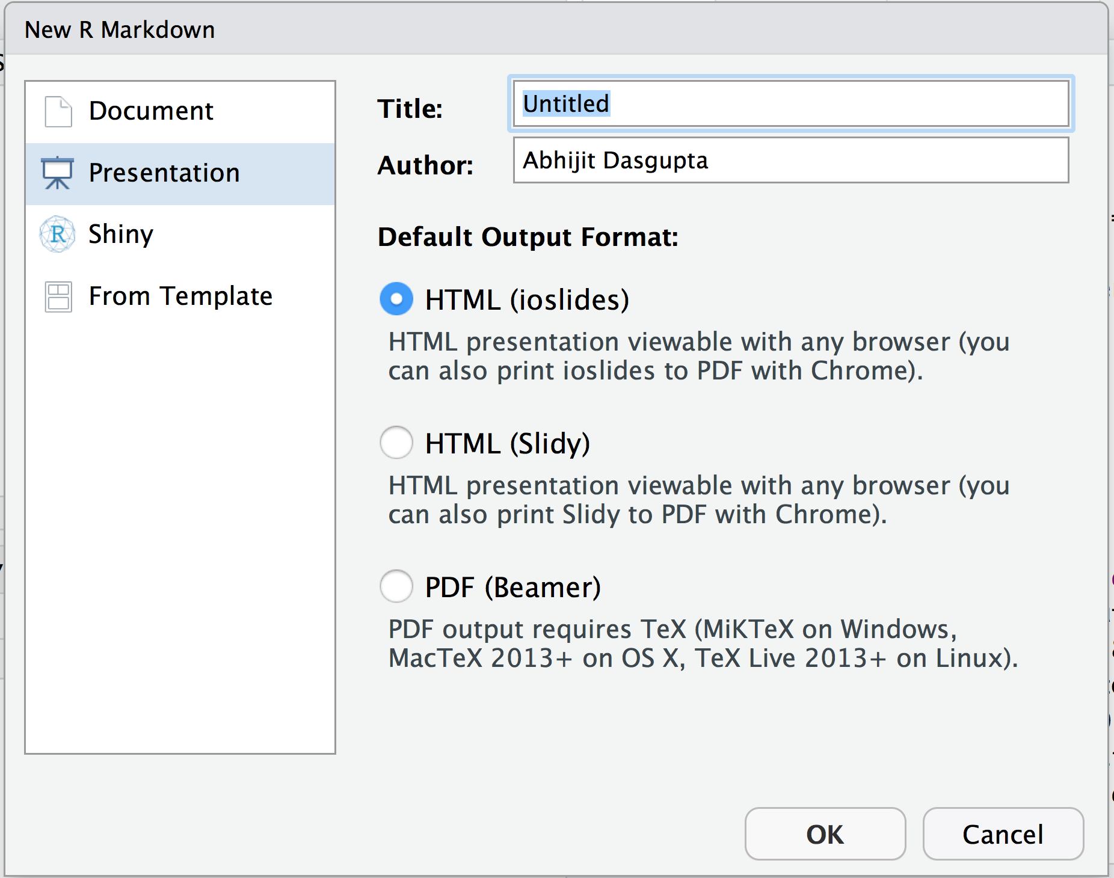
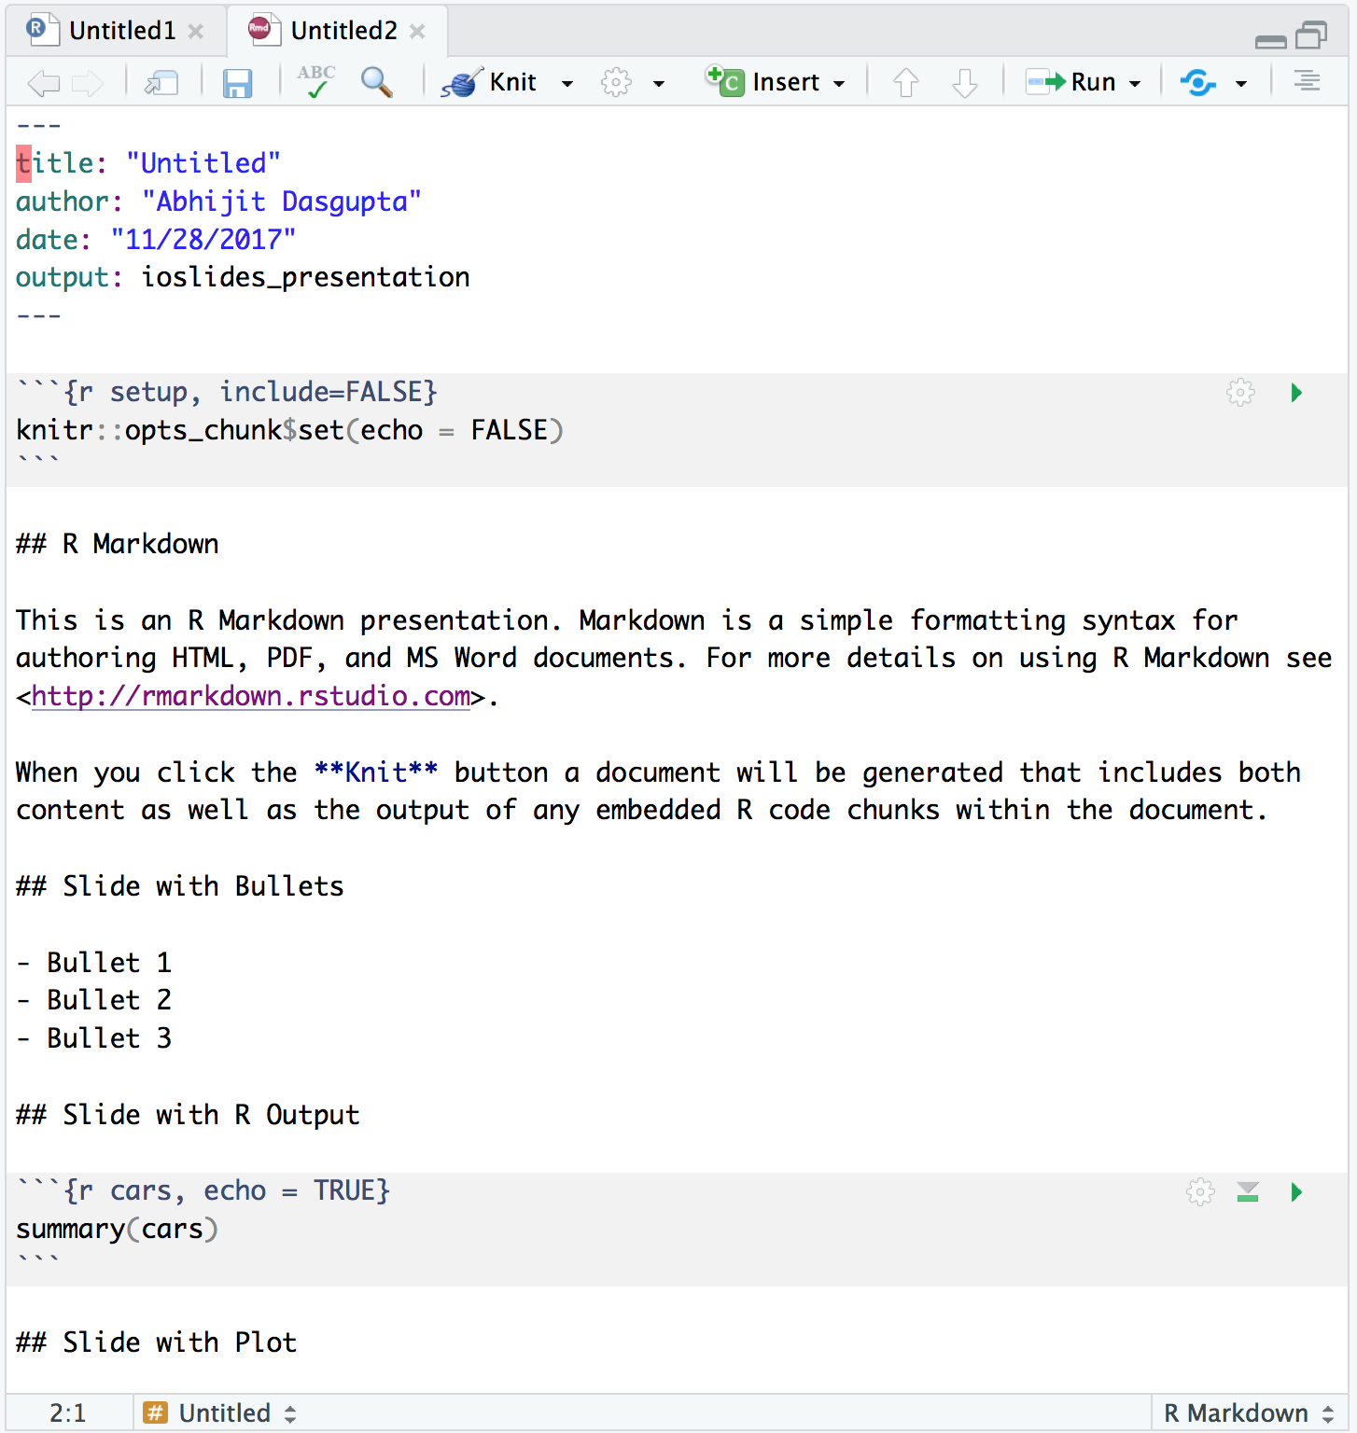
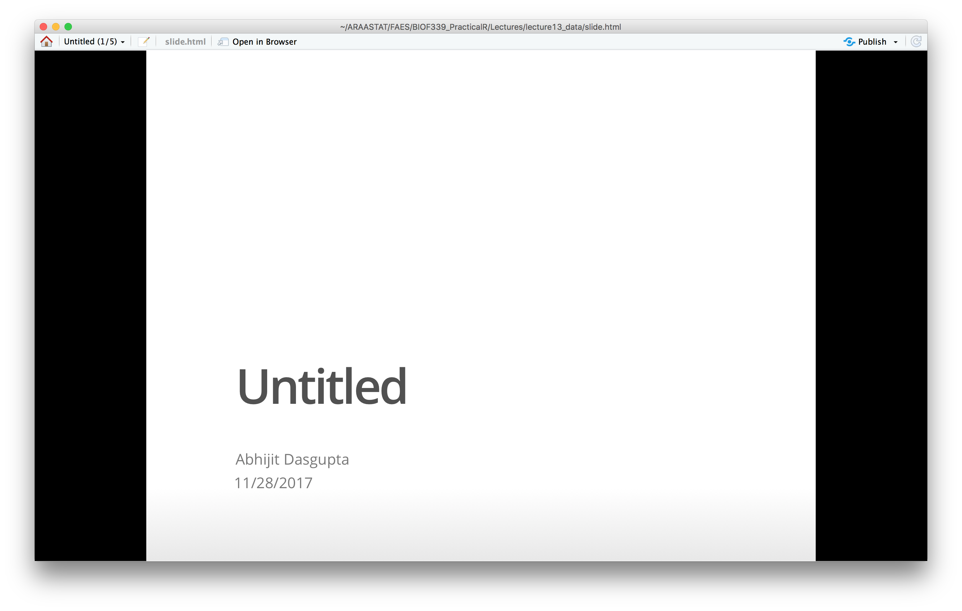
Almost all our slides in BIOF339 are written this way

Slide 35
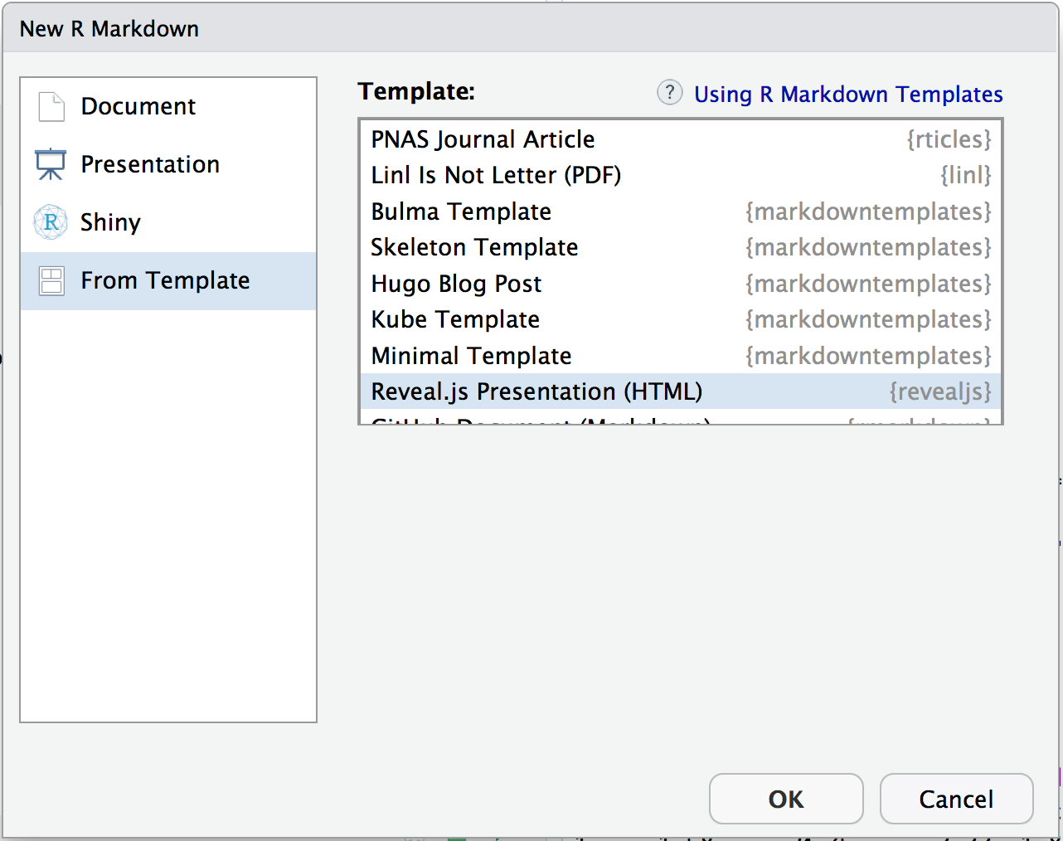
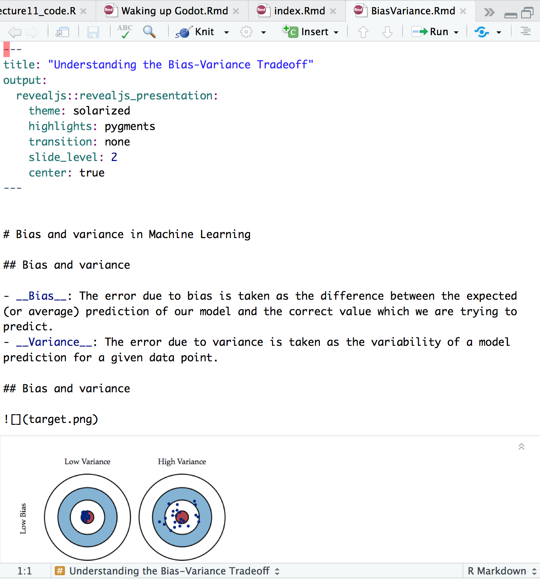

Notes:
The slide is a link to the actual presentation

Slide 36
The possibilities
Link
Notes:
The link goes to the R Markdown Gallery

Slide 37
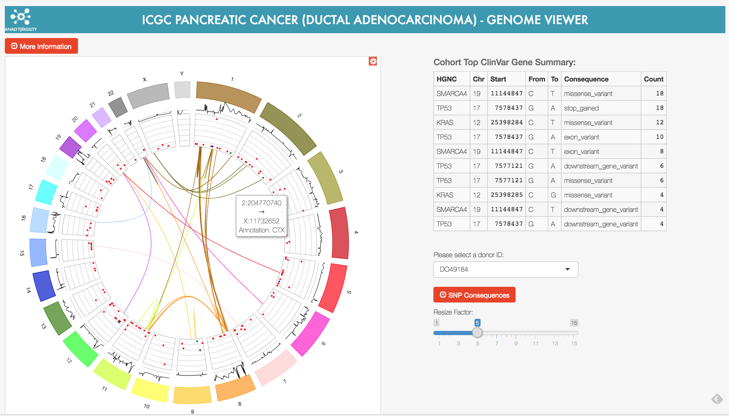
Shiny
Interactive web pages using R
Notes:
The graphic is a link

Slide 38
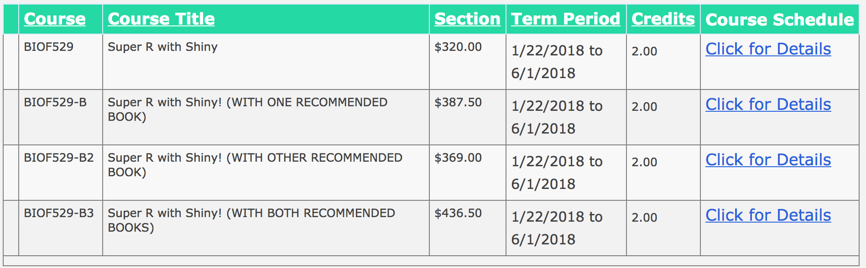
FAES course next sem

Slide 39
R Notebooks

Slide 40
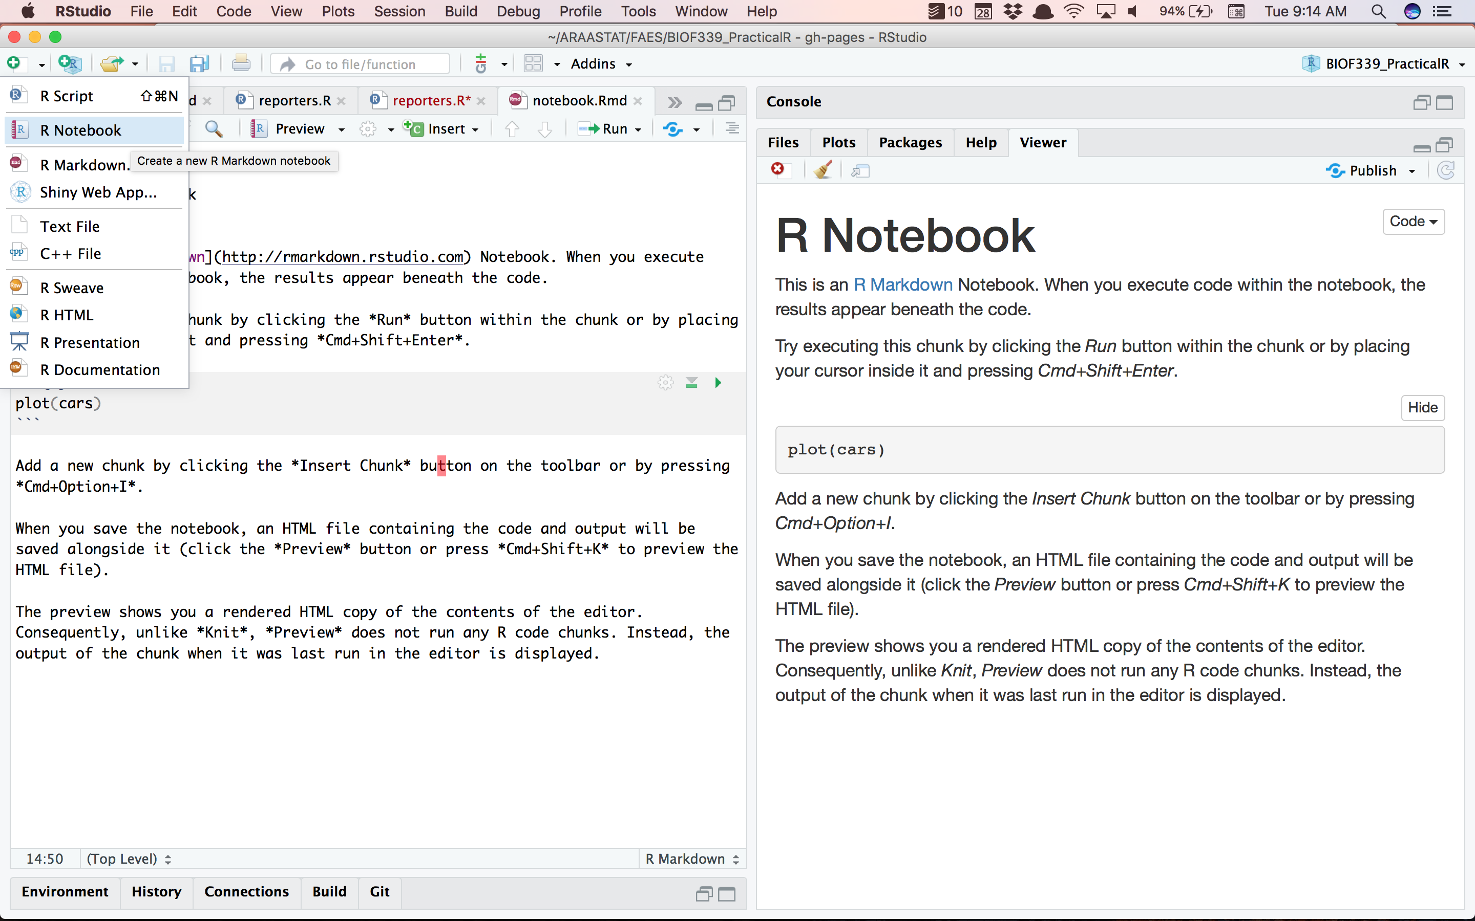

Slide 41
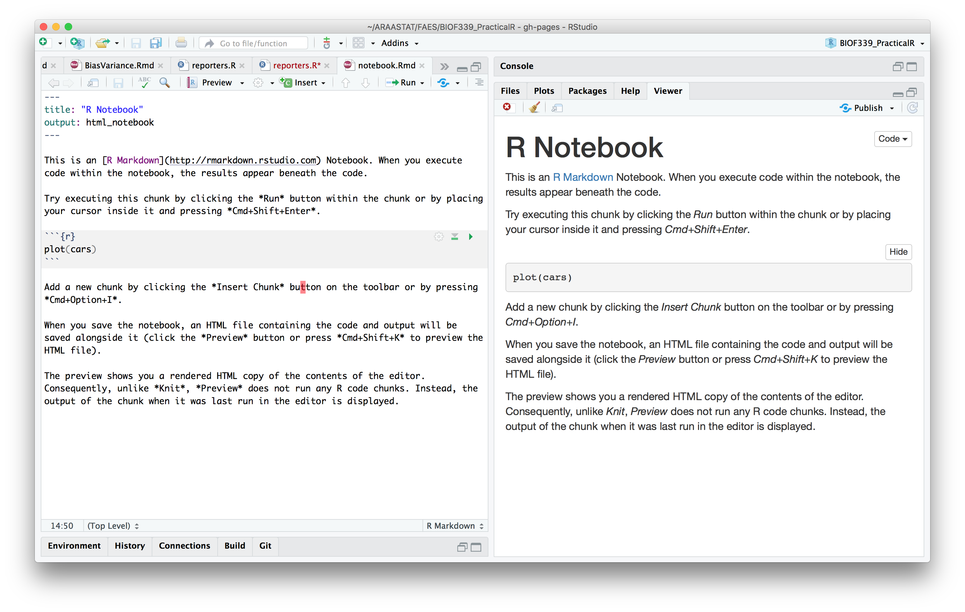

Slide 42
Spinning documents from code

Slide 43
Spin
You can generate documents directly from R script files
You use a particular form of comment, that starts with #’
This process gets rid of copying code
This allows you to create a “lab notebook” with properly formatted comments that you can print into a document

Slide 44
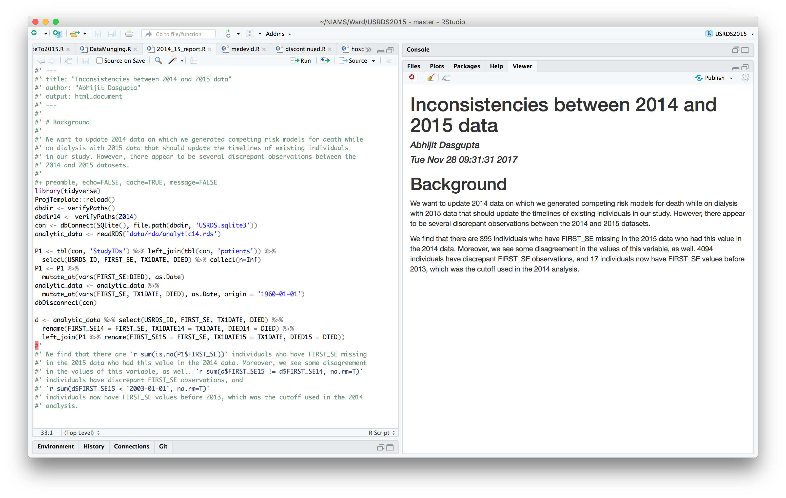
We’ll talk about this next week
Notes:
This is some exploratory work that Abhijit is doing. The text appears as comments to R, so I can run the code in R without problems. If I spin it (purple outlined icon) then it gets processed through rmarkdown
We’ll talk about RStudio Projects, and Abhijit’s ProjTemplate package, next week.

Slide 45
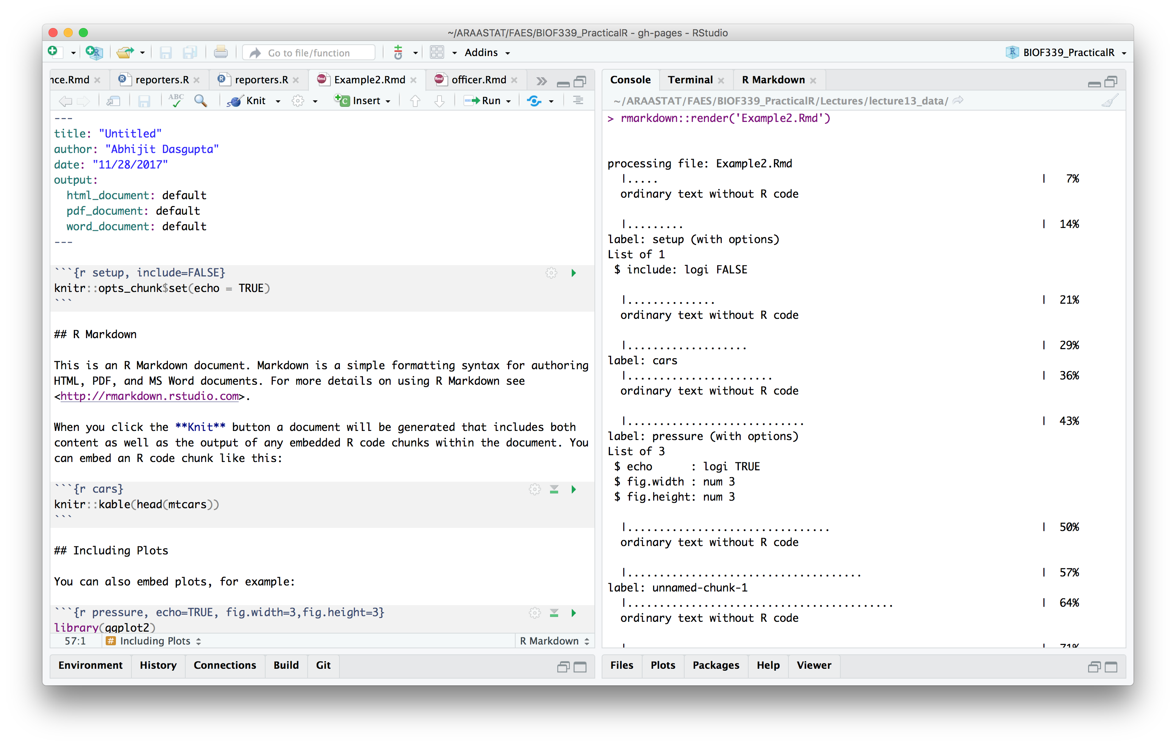
Weaving documents programmatically
This part of the header determines the type of document produced
Notes:
Use rmarkdown::render to create the processed document.
The YAML code under output determines the type of output produced

Slide 46
Weaving documents programmatically
Notes:
Use rmarkdown::render to create the processed document.
You can also specify the output type in the code

Slide 47
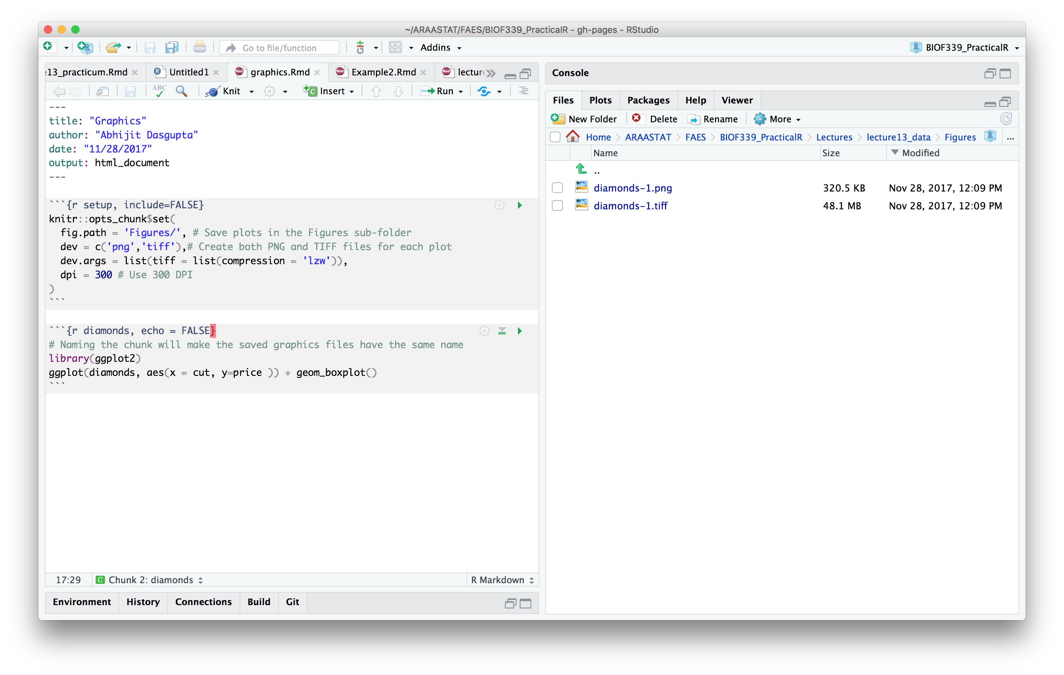
Graphics options
Notes:
The graphic is stored in the Figures folder, and is named based on the name of the chunk

Slide 48
Directly to MS Office

Slide 49
The ReporteRs package
Allows you to directly create Word documents and PowerPoint
Uses Java, so installation can be finicky
See this blog post for installation suggestions for rJava

Slide 50
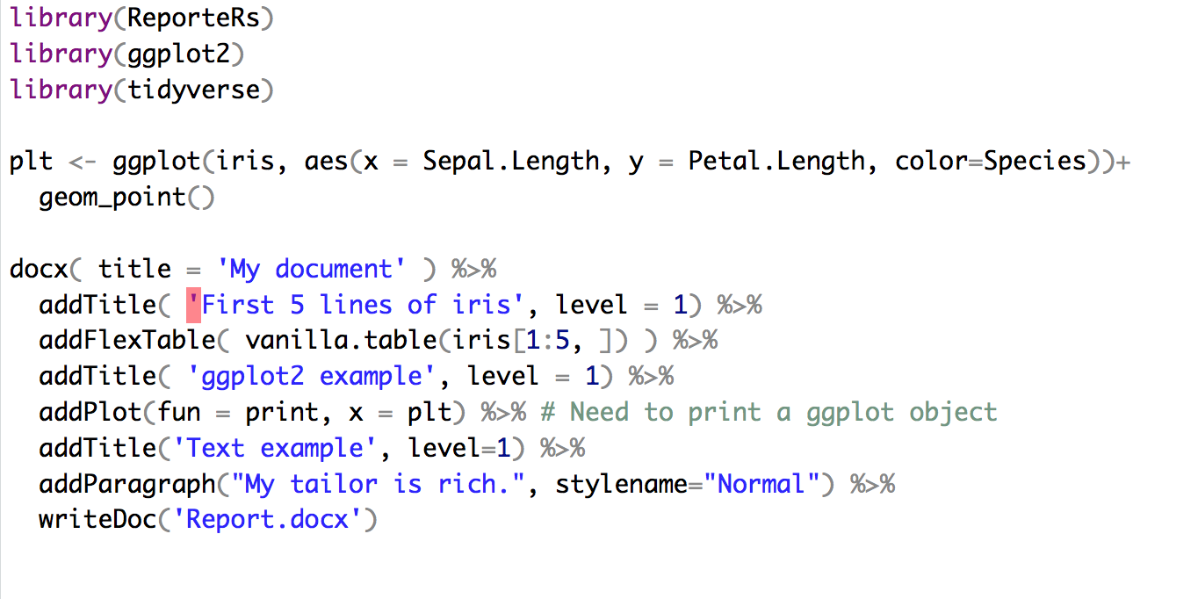
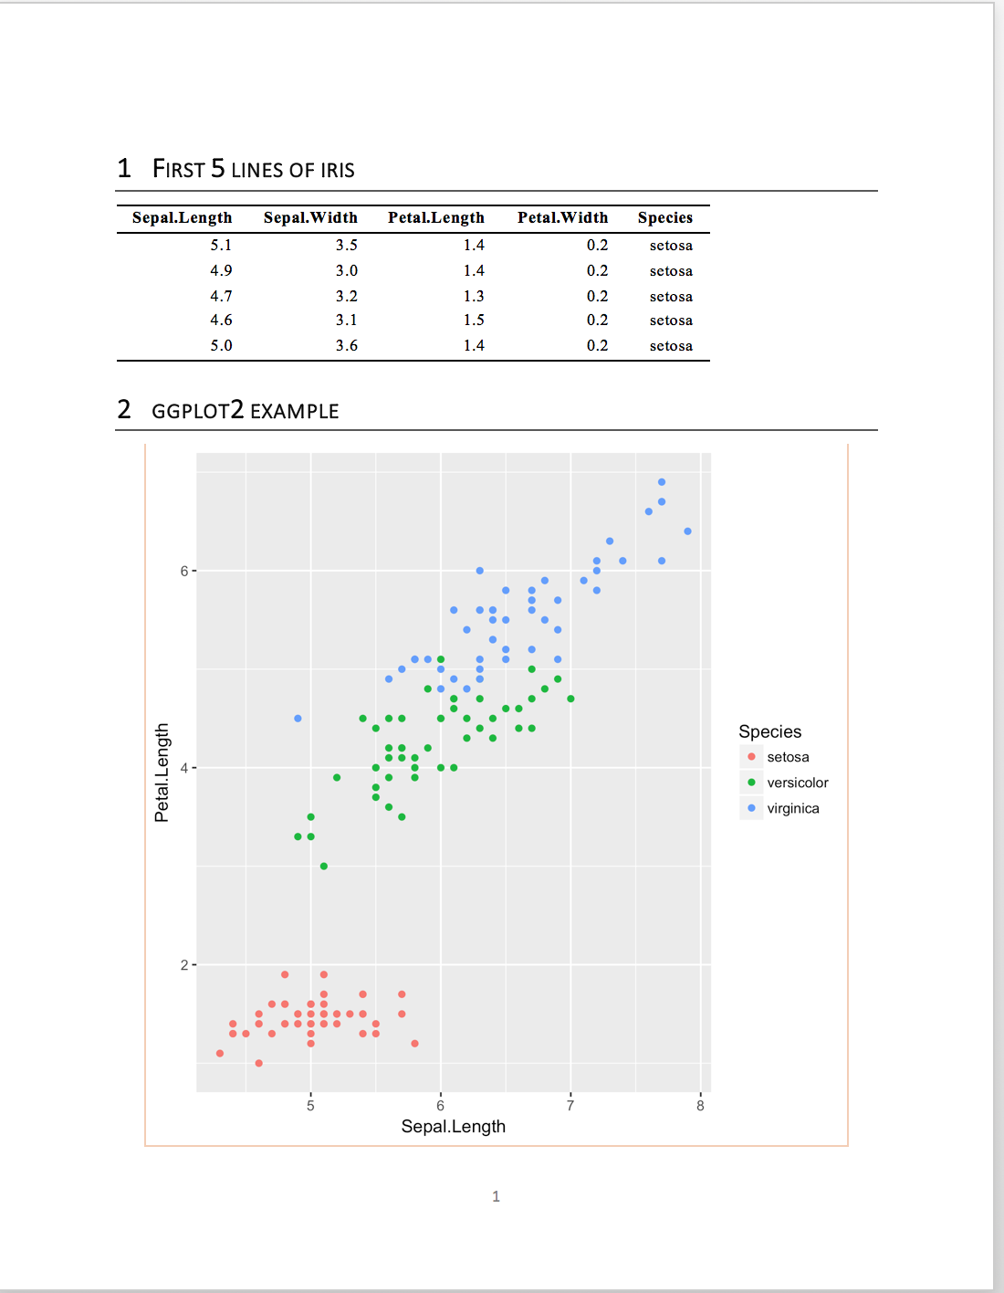
The ReporteRs package

Slide 51
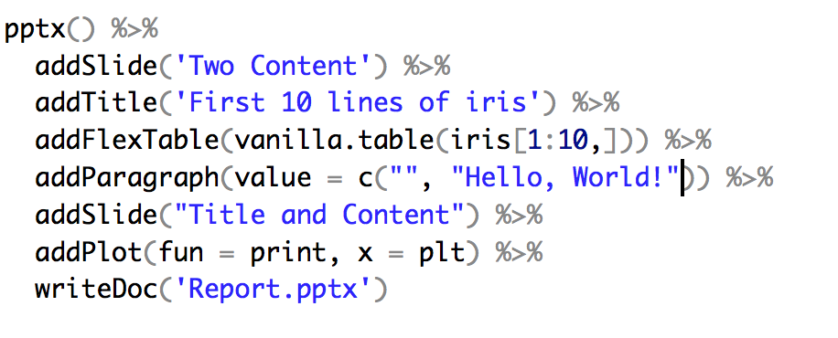
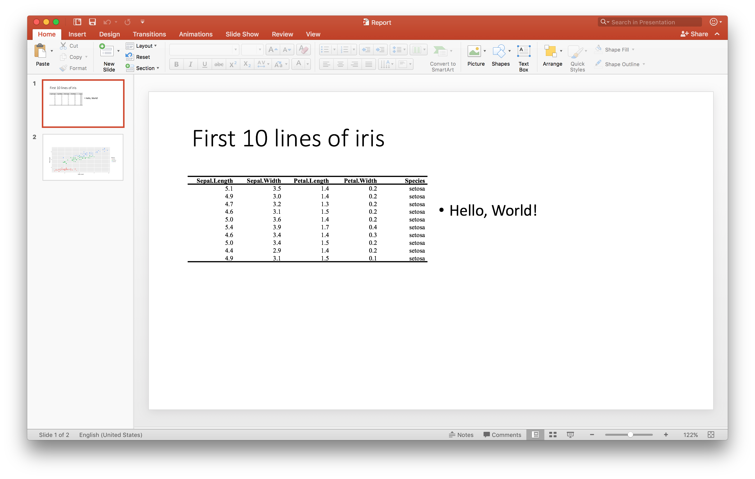
The ReporteRs package

Slide 52
The officer package
ReporteRs has been updated by the officer package
Removed dependency on Java
Syntax is a bit different
Brand new

Slide 53
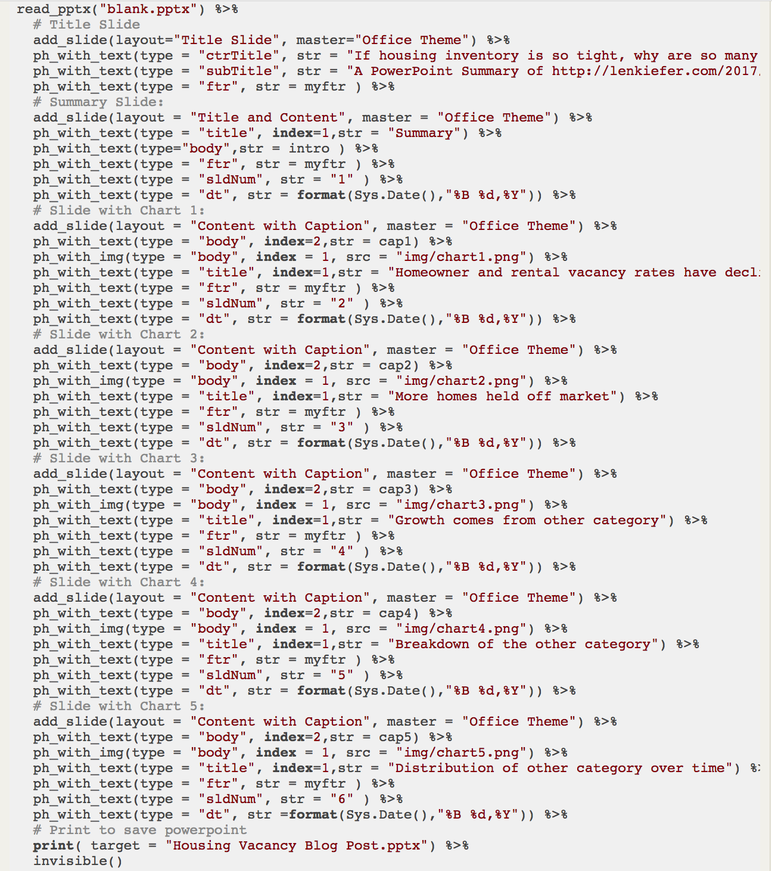
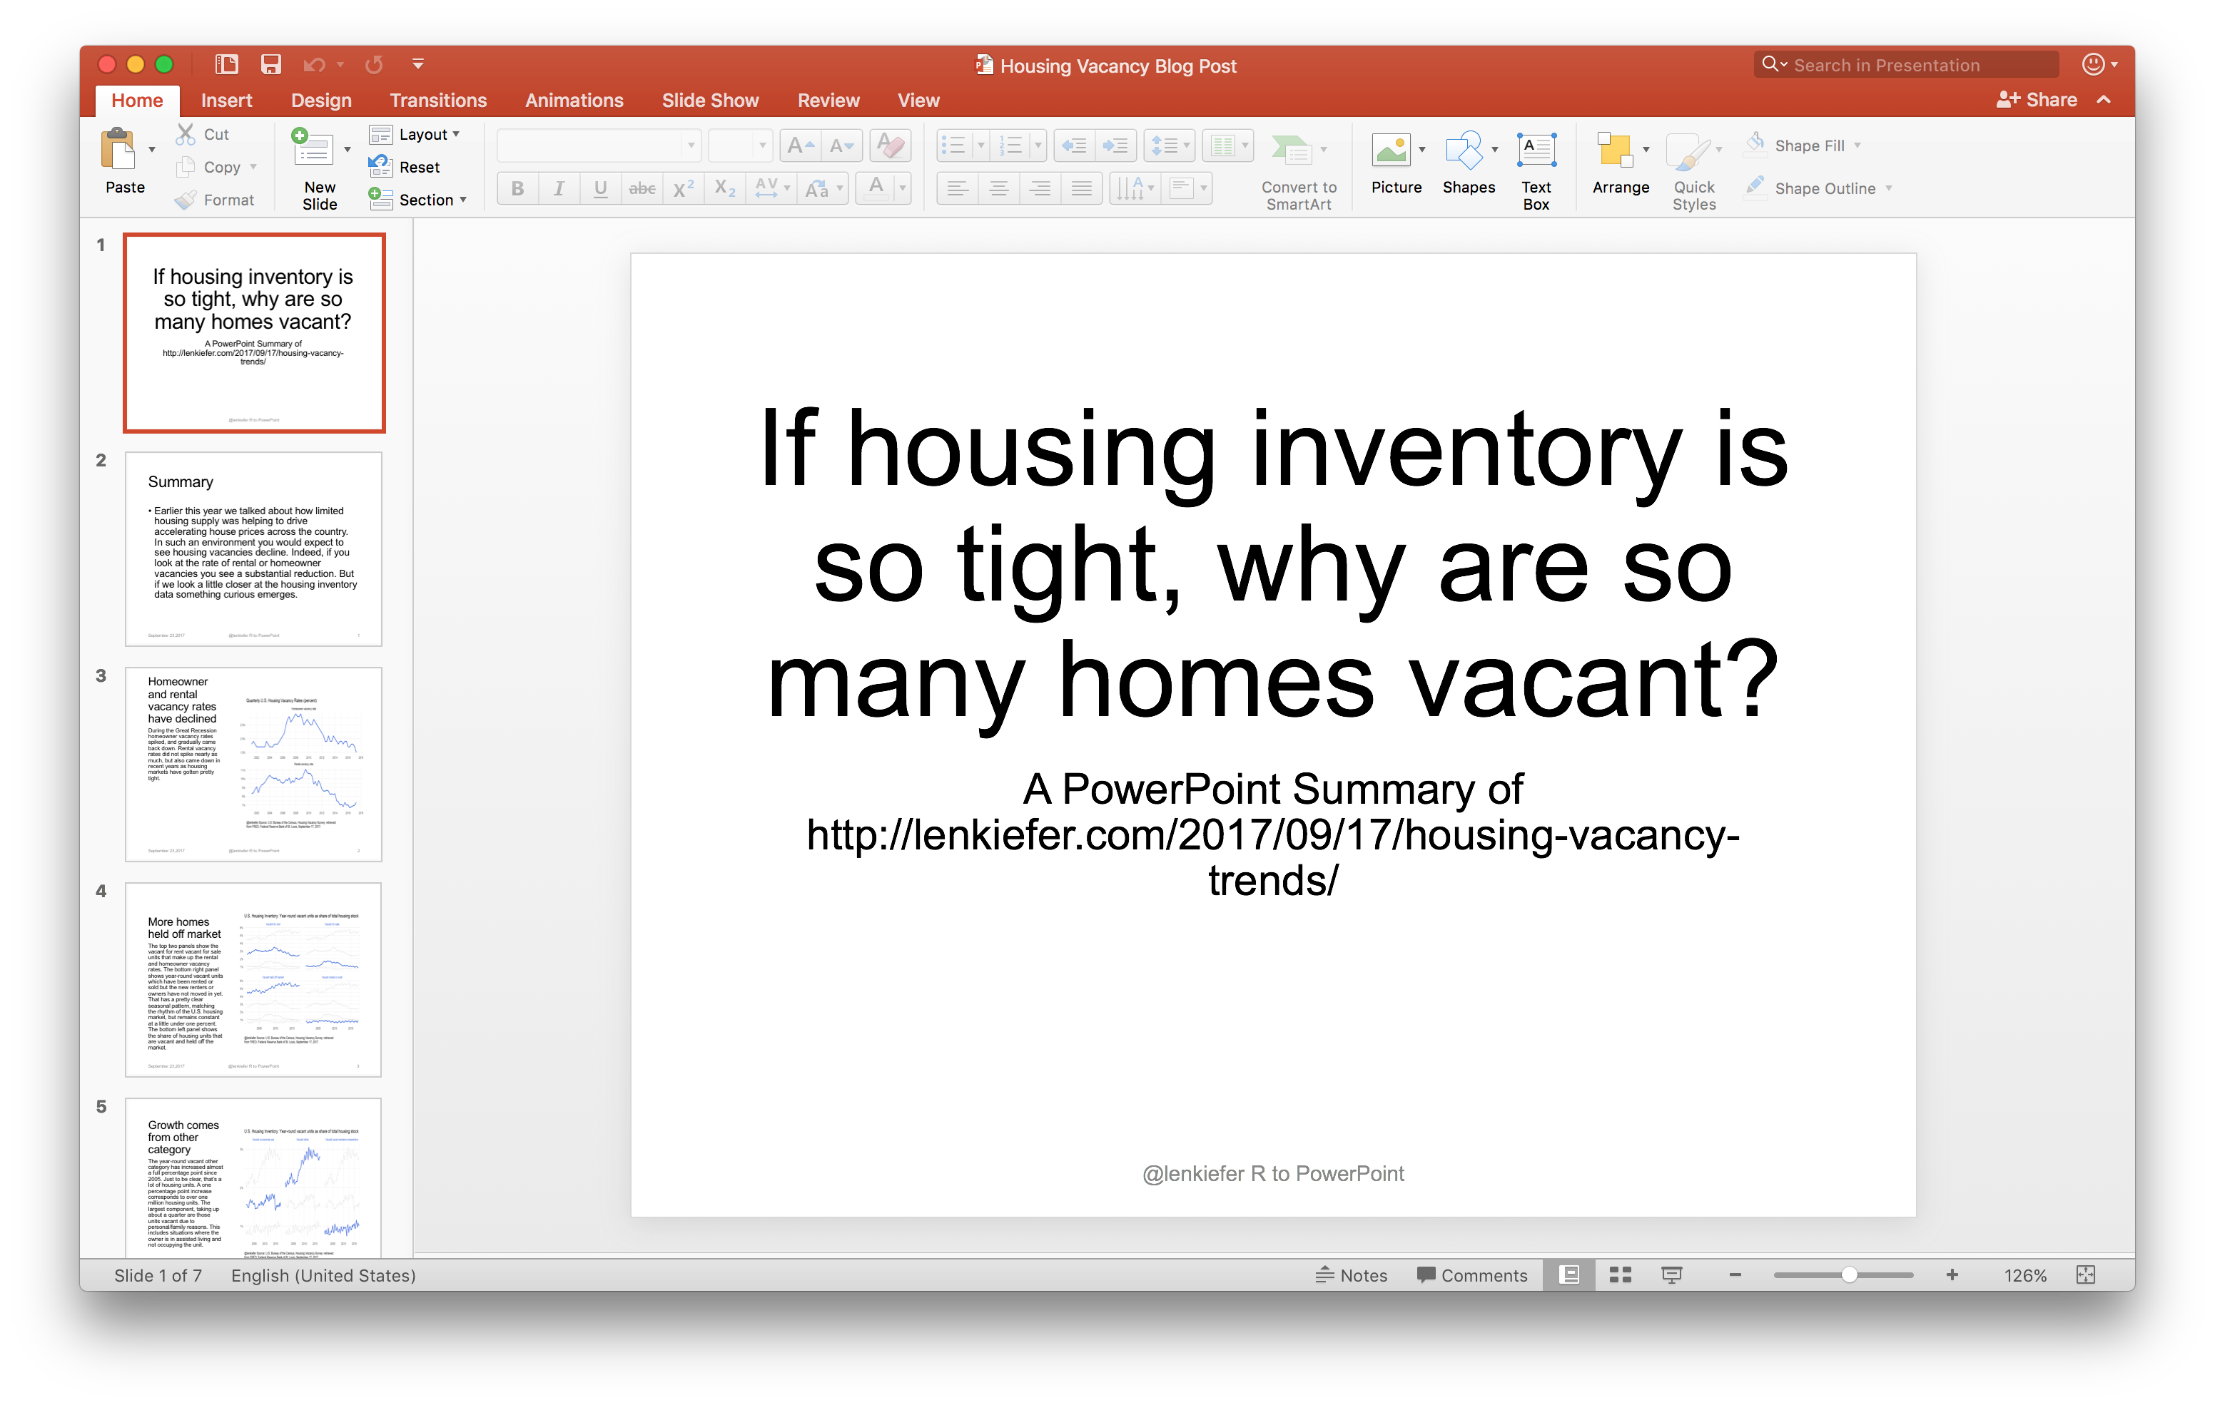
The officer package
From http://lenkiefer.com/2017/09/23/crafting-a-powerpoint-presentation-with-r/

Slide 54
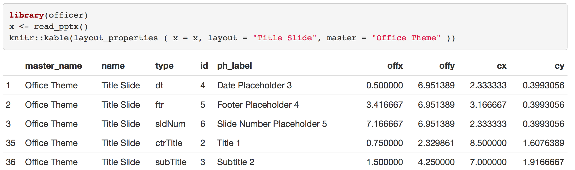
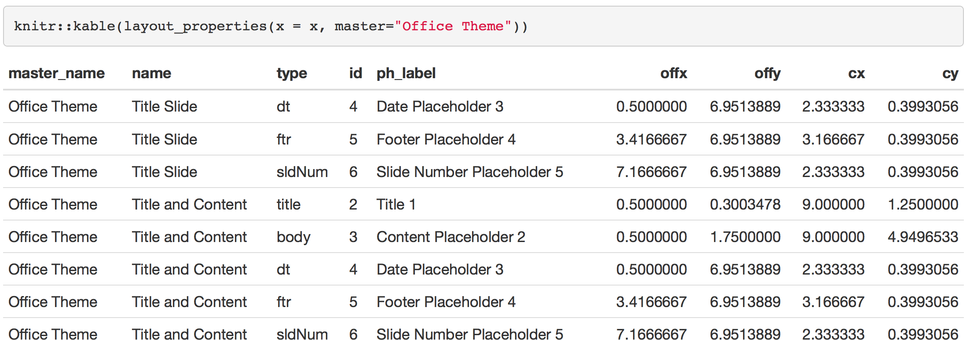
The officer package
From http://lenkiefer.com/2017/09/23/crafting-a-powerpoint-presentation-with-r/
Notes:
How do we find out these types? Use layout_properties

Slide 55
data.frame to Excel

Slide 56
The openxlsx package
Fast
Doesn’t depend on Java
Can do conditional formatting of cells (link

Slide 57
Conclusion
Keeping text and code together allows for easy reproduction of documents
This also ensures that there are no mistakes in the results, since the code to create them is already in the raw document
No copy/paste errors
This also allows for a relatively easy revision cycle

Slide 58
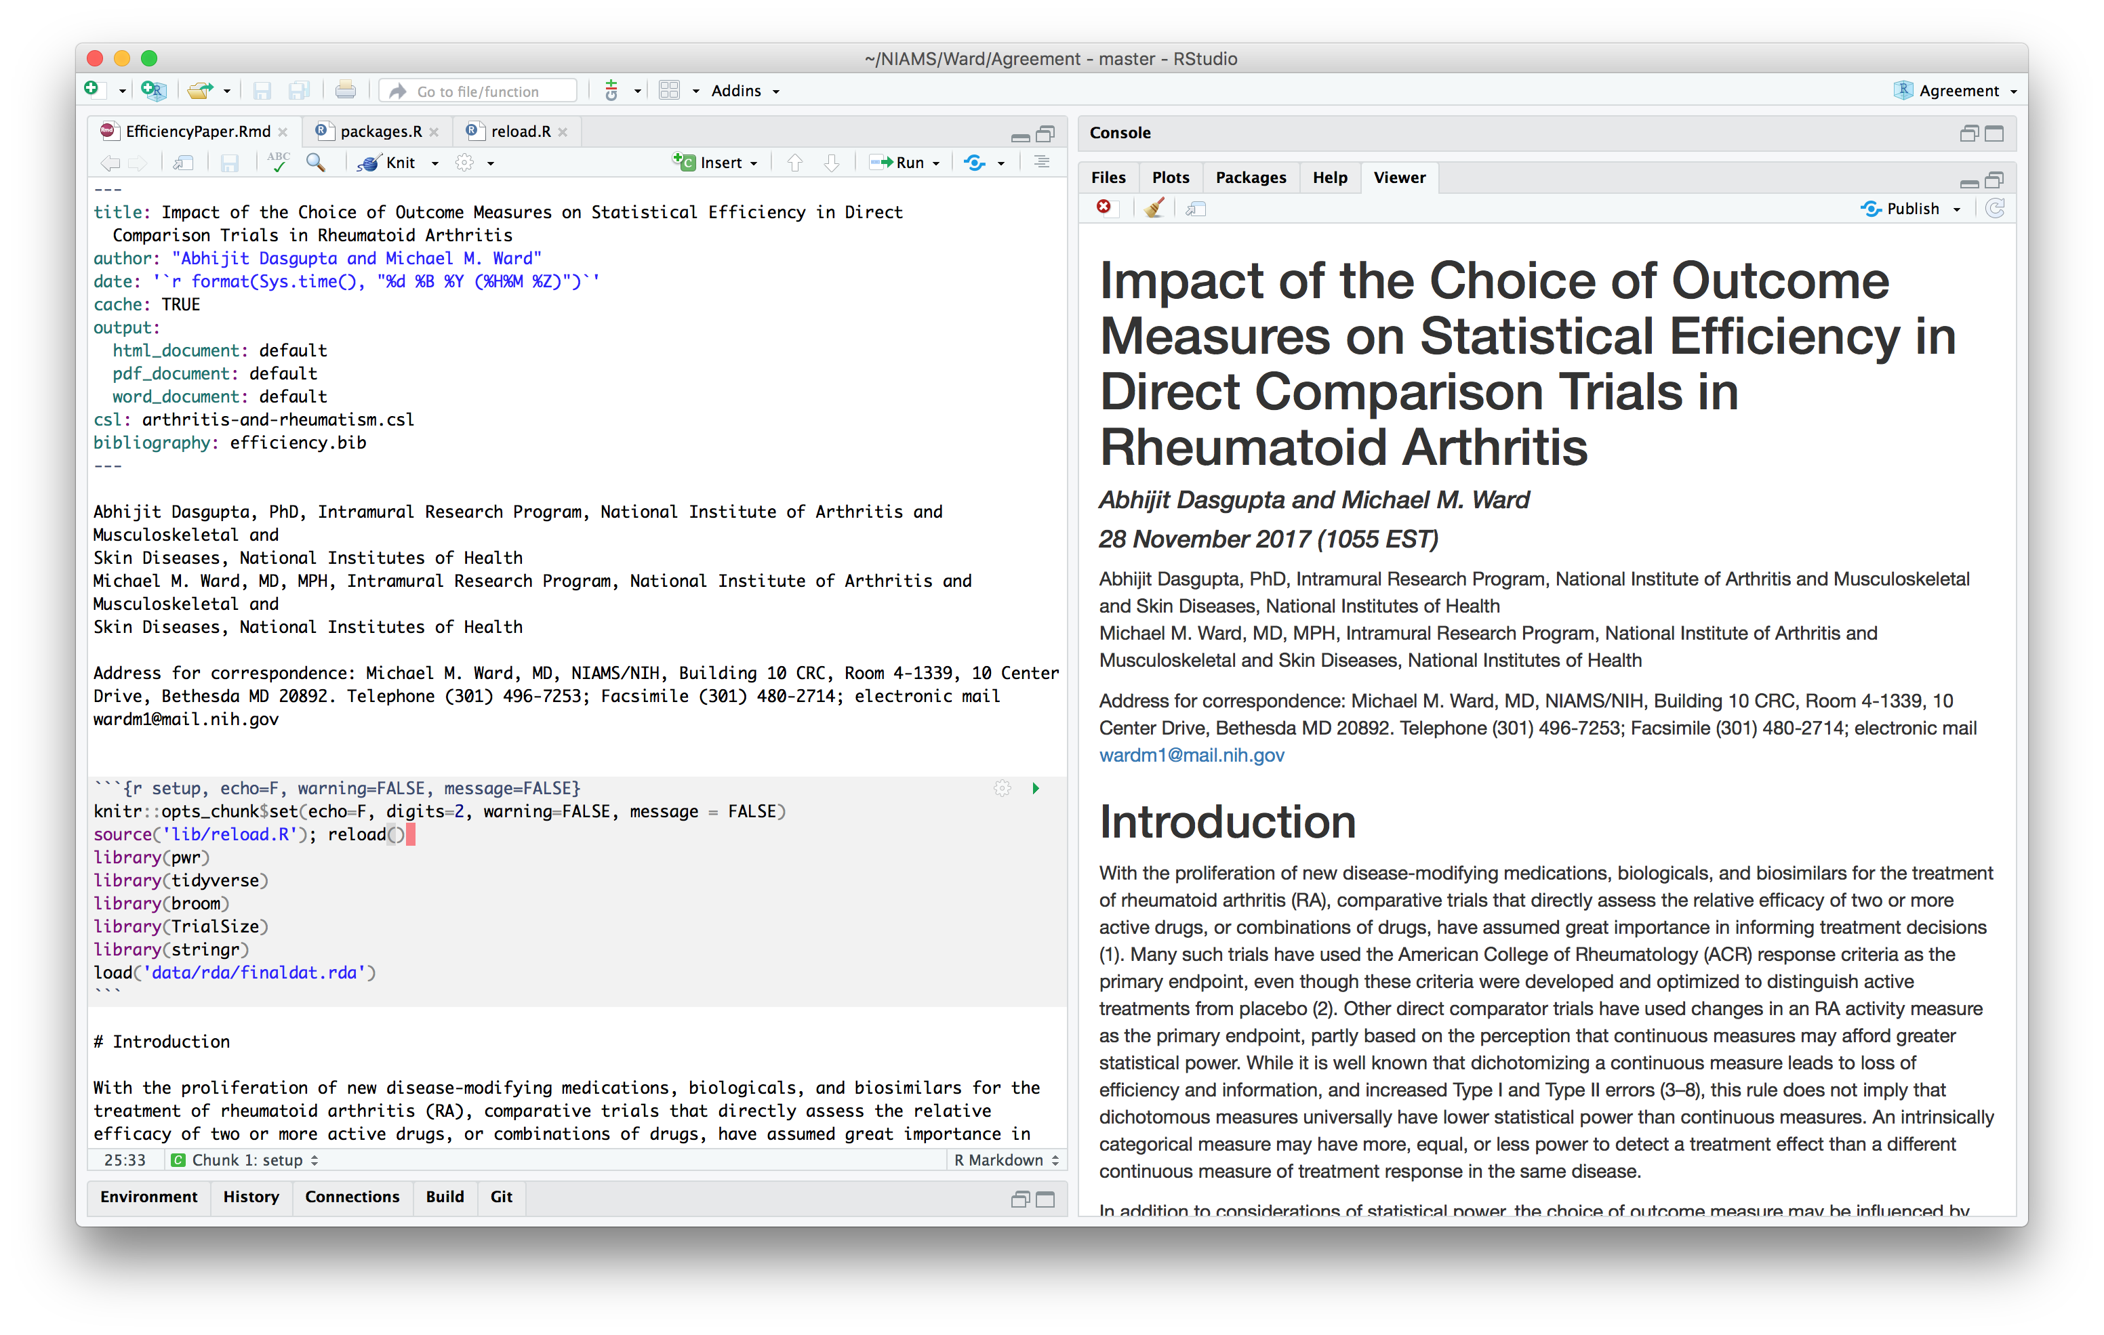
A full paper
Notes:
csl: The Citation Style Language file for the journal
cache = TRUE: cache computations to speed up processing
bibliography: Abhijit uses BiBTeX, hence the .bib file. You can use Endnote as well
The date field in the header prints the current date and time

